Slide 1
Mini-course on algorithmic aspects of stochastic games and related models
Marcin Jurdziński (University of Warwick)
Peter Bro Miltersen (Aarhus University)
Uri Zwick (武熠) (Tel Aviv University)
Oct. 31 – Nov. 2, 2011

Slide 2
Day 1 Monday, October 31
Uri Zwick (武熠) (Tel Aviv University) Perfect Information Stochastic Games

Slide 3
Day 2 Tuesday, November 1
Marcin Jurdziński (University of Warwick) Parity Games

Slide 4
Day 3 Wednesday, November 2
Peter Bro Miltersen (Aarhus University)
Imperfect Information Stochastic Games

Slide 5
Day 1 Monday, October 31
Uri Zwick (武熠) (Tel Aviv University) Perfect Information Stochastic Games
Lectures 1-2 From shortest paths problems to 2-player stochastic games

Slide 6
Warm-up: 1-player “games”
Reachability
Shortest / Longest paths
Minimum / Maximum mean payoff
Minimum / Maximum discounted payoff

Slide 7
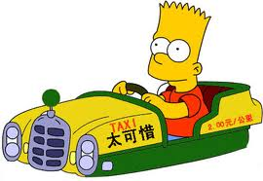
1-Player reachability “game”
From which states can we reach the target?

Slide 8
1-Player shortest paths “game”
Edges/actions have costs
Find shortest paths to target

Slide 9
1-Player shortest paths “game” with positive and negative weights
Shortest paths not defined if there is a negative cycle

Slide 10
1-Player LONGEST paths “game” with positive and negative weights
LONGEST paths not defined if there is a positive cycle
Exercise 1a: Isn’t the LONGEST paths problem NP-hard?

Slide 11
1-Player maximum mean-payoff “game”
No target
Traverse one edge per day
Maximize per-day profit
Find a cycle with maximum mean cost
Exercise 1b: Show that finding a cycle with maximum total cost is NP-hard.

Slide 12
1-Player discounted payoff “game”
1元 gained on the i-th day is worth only λ^{i} 元 at day 0
Equivalently, each day taxi breaks down with prob. 1−λ

Slide 13
The real fun begins: 1½-player games
Add stochastic actions and get Stochastic Shortest Paths and Markov Decision Processes
Maximum / minimum Reachability
Longest / Shortest stochastic paths
Maximum / minimum mean payoff
Maximum / minimum discounted payoff

Slide 14
Stochastic shortest paths (SSPs)
Minimize the expected cost of getting to the target

Slide 15
Stochastic shortest paths (SSPs)
Exercise 2:
Find the optimal policy for this SSP.
What is the expected cost of getting to IIIS?

Slide 16
Policies / Strategies
A rule that, given the full history of the play, specifies the next action to be taken
A deterministic (pure) strategy is a strategy that does not use randomization
A memoryless strategy is a strategy that only depends on the current state
A positional strategy is a deterministic memoryless strategy

Slide 17
Exercise 3:
Prove (directly) that if a SSP problem has an optimal policy, it also has a positional optimal policy

Slide 18
Stochastic shortest paths (SSPs)

Slide 19
Stopping SSP problems
A policy π is stopping if by following it we reach the target from each state with probability 1
An SSP problem is stopping if every policy is stopping
Reminiscent of acyclic shortest paths problems

Slide 20
Positional policies/strategies
Theorem: A SSP problem has an optimal policy iff there is no “negative cycle”
Theorem: If an SSP problem has an optimal policy, it also has a positional optimal policy
Theorem: A stopping SSP problem has an optimal policy, and hence a positional optimal policy

Slide 21
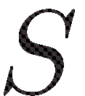
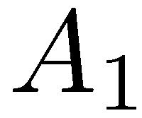
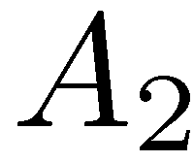
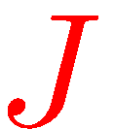
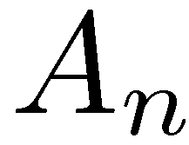
Matrix notation
1
1
1
1
1
1
1

Slide 22
Evaluating a stopping policy
(stopping) policy → (absorbing) Markov Chain
Values of a fixed policy can be found by solving a system of linear equations

Slide 23
Evaluating a stopping policy

Slide 24
Improving switches

Slide 25
Improving a policy

Slide 26
Improving a policy

Slide 27
Policy iteration (Strategy improvement)
[Howard ’60]

Slide 28
Potential transformations

Slide 29
Potential transformations

Slide 30
Using values as potentials

Slide 31
Optimality condition

Slide 32
Solving Stochastic shortest paths
and Markov Decision Processes
Can be solved using the policy iteration algorithm
Is there a polynomial time version of the policy iteration algorithm ???
Can be solved in polynomial time using a reduction to Linear Programming

Slide 33
Dual LP formulation for stochastic shortest paths
[d’Epenoux (1964)]

Slide 34
Primal LP formulation for stochastic shortest paths
[d’Epenoux (1964)]

Slide 35
Solving Stochastic shortest paths
and Markov Decision Processes
Can be solved in polynomial time using a reduction to Linear Programming
Current algorithms for Linear Programming are polynomial but not strongly polynomial
Is there a strongly polynomial algorithm ???
Is there a strongly polynomial time version of the policy iteration algorithm ???

Slide 36
Markov Decision Processes [Bellman ’57] [Howard ’60] …
Discounted version
Limiting average version
One (and a half) player
No target
Process goes on forever

Slide 38
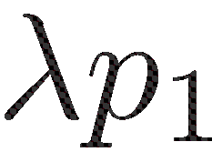
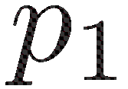
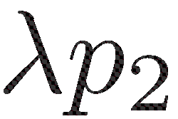
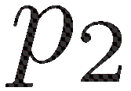
Discounted MDPs

Slide 39
Discounted MDPs

Slide 40
Discounted MDPs

Slide 41
Non-discounted MDPs

Slide 42
More fun: 2-player games
Introduce an adversary
All actions are deterministic
Reachability
Longest / Shortest paths
Maximum / Minimum mean payoff
Maximum / Minimum discounted payoff

Slide 43
2-Player mean-payoff game
[Ehrenfeucht-Mycielski (1979)]
No target
Traverse one edge per day
Maximize / minimize per-day profit
Various pseudo-polynomial algorithms
Is there a polynomial time algorithm ???

Slide 45
Yet more fun: 2½-player games
Introduce an adversary
and stochastic actions
Maximum / Minimum Reachability
Longest / Shortest stochastic paths
Maximum / Minimum mean payoff
Maximum / Minimum discounted payoff

Slide 46
Turn-based Stochastic Payoff Games [Shapley ’53] [Gillette ’57] … [Condon ’92]
No sinks
Payoffs on actions
Limiting average version
Discounted version
Both players have optimal positional strategies
Can optimal strategies be found in polynomial time?

Slide 47
Discounted 2½-player games

Slide 48
Optimal Values in 2½-player games
positional
general
positional
general
Both players have positional optimal strategies
There are strategies that are optimal for every starting position

Slide 49
2½G ∈ NP ∩ co-NP
Deciding whether the value of a state is at least (at most) v is in NP ∩ co-NP
To show that value ≥ v , guess an optimal strategy σ for MAX
Find an optimal counter-strategy τ for min by solving the resulting MDP.
Is the problem in P ?

Slide 50
Discounted 2½-player games
Strategy improvement first attempt

Slide 51
Discounted 2½-player games
Strategy improvement second attempt

Slide 52
Discounted 2½-player games
Strategy improvement correct version

Slide 53
Turn-based Stochastic Payoff Games (SPGs) long-term planning in a stochastic and adversarial environment
2½-players
Mean Payoff Games (MPGs) adversarial non-stochastic
Markov Decision Processes (MDPs) non-adversarial stochastic
2-players
1½-players
Deterministic MDPs (DMDPs) non-stochastic, non-adversarial
1-player

Slide 54
Day 1 Monday, October 31
Uri Zwick (武熠) (Tel Aviv University) Perfect Information Stochastic Games
Lecture 1½
Upper bounds for policy iteration algorithm

Slide 55
Complexity of Strategy Improvement
Greedy strategy improvement for non-discounted 2-player and 1½-player games is exponential !
[Friedmann ’09] [Fearnley ’10]
A randomized strategy improvement algorithm for 2½-player games runs in sub-exponential time
[Kalai (1992)] [Matousek-Sharir-Welzl (1992)]
Greedy strategy improvement for 2½-player games with a fixed discount factor is strongly polynomial
[Ye ’10] [Hansen-Miltersen-Z ’11]

Slide 56
The RANDOM FACET algorithm [Kalai (1992)] [Matousek-Sharir-Welzl (1992)] [Ludwig (1995)]
A randomized strategy improvement algorithm
Initially devised for LP and LP-type problems
Applies to all turn-based games
Sub-exponential complexity
Fastest known for non-discounted 2(½)-player games
Performs only one improving switch at a time
Work with strategies of player 1
Find optimal counter strategies for player 2

Slide 57
The RANDOM FACET algorithm

Slide 58
The RANDOM FACET algorithm
Analysis

Slide 59
The RANDOM FACET algorithm
Analysis

Slide 60
The RANDOM FACET algorithm
Analysis

Slide 61
The RANDOM FACET algorithm
Analysis

Slide 62
Day 1 Monday, October 31
Uri Zwick (武熠) (Tel Aviv University) Perfect Information Stochastic Games
Lecture 3
Lower bounds for policy iteration algorithm

Slide 63
Oliver Friedmann – Univ. of Munich Thomas Dueholm Hansen – Aarhus Univ. Uri Zwick (武熠) – Tel Aviv Univ.
Subexponential lower bounds for randomized pivoting rules for the simplex algorithm
单纯形算法中随机 主元旋转规则的次指数级下界
TexPoint fonts used in EMF.
Read the TexPoint manual before you delete this box.: AAAAAA

Slide 64
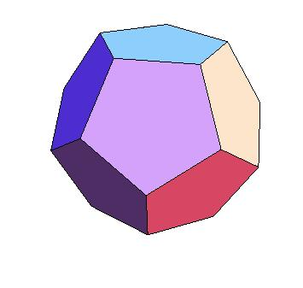
Linear Programming
Maximize a linear objective function subject to a set of linear equalities and inequalities

Slide 65
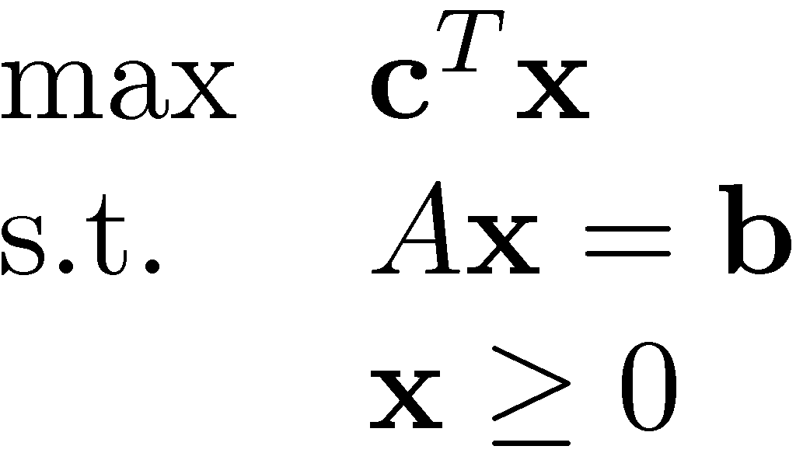
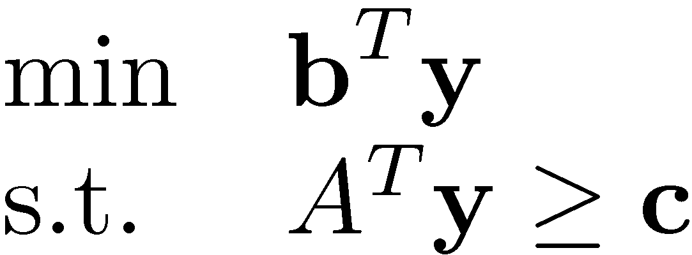
Linear Programming
Simplex algorithm (Dantzig 1947)
Ellipsoid algorithm (Khachiyan 1979)
Interior-point algorithm (Karmakar 1984)

Slide 66
The Simplex Algorithm Dantzig (1947)
Move up, along an edge to a neighboring vertex, until reaching the top

Slide 67
Pivoting Rules – Where should we go?
Largest improvement?
Largest slope?
…

Slide 68
Deterministic pivoting rules
Largest improvement
Largest slope
Dantzig’s rule – Largest modified cost
Bland’s rule – avoids cycling
Lexicographic rule – also avoids cycling
All known to require an exponential number of steps, in the worst-case
Klee-Minty (1972)
Jeroslow (1973), Avis-Chvátal (1978),
Goldfarb-Sit (1979), … , Amenta-Ziegler (1996)

Slide 69
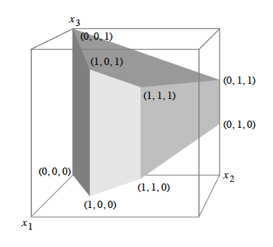
Klee-Minty cubes (1972)
Taken from a paper by Gärtner-Henk-Ziegler

Slide 70
Is there a polynomial pivoting rule?
Is the diameter polynomial?
Hirsch conjecture (1957): The diameter of a d-dimensional, n-faceted polytope is at most n−d
Refuted recently by Santos (2010)!
Diameter is still believed to be polynomial (See, e.g., the polymath3 project)
Quasi-polynomial (n^{log d+1}) upper bound Kalai-Kleitman (1992)

Slide 71
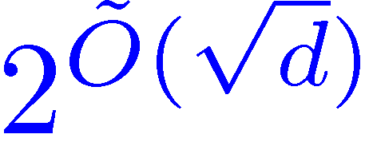
Randomized pivoting rules
Random-Edge
Choose a random improving edge
Random-Facet
If there is only one improving edge, take it. Otherwise, choose a random facet containing the current vertex and recursively find the optimum within that facet.
[Kalai (1992)] [Matoušek-Sharir-Welzl (1996)]
Random-Facet is sub-exponential!
Are Random-Edge and Random-Facet polynomial ???

Slide 72
Abstract objective functions (AOFs)
Acyclic Unique Sink Orientations (AUSOs)
Every face should have a unique sink

Slide 73
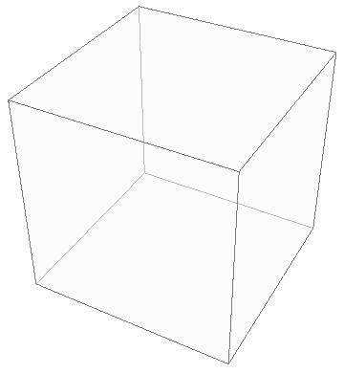
AUSOs of n-cubes
2n facets 2^{n} vertices
USOs and AUSOs
Stickney, Watson (1978)
Morris (2001)
Szabó, Welzl (2001)
Gärtner (2002)
The diameter is exactly n
Bypassing the diameter issue!

Slide 74
AUSO results
Random-Facet is sub-exponential [Kalai (1992)] [Matoušek-Sharir-Welzl (1996)]
Sub-exponential lower bound for Random-Facet [Matoušek (1994)]
Sub-exponential lower bound for Random-Edge [Matoušek-Szabó (2006)]
Lower bounds do not correspond to actual linear programs
Can geometry help?

Slide 75
LP results
Explicit LPs on which Random-Facet and Random-Edge make an expected sub-exponential number of iterations
Technique
Consider LPs that correspond to Markov Decision Processes (MDPs)
Observe that the simplex algorithm on these LPs corresponds to the Policy Iteration algorithm for MDPs
Obtain sub-exponential lower bounds for the Random-Facet and Random-Edge variants of the Policy Iteration algorithm for MDPs, relying on similar lower bounds for Parity Games (PGs)

Slide 76
Dual LP formulation for MDPs

Slide 77
Primal LP formulation for MDPs

Slide 78
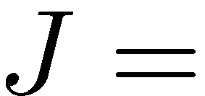
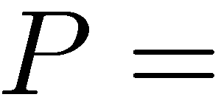
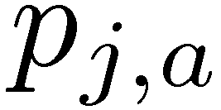
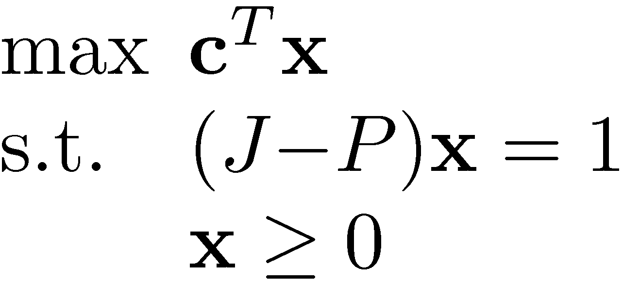
Primal and Dual LP formulations for unichain MDPs in matrix form
actions
111111
111111
111111
…
11111
states
Vertex/action incidence matrix
Transition probabilities

Slide 79
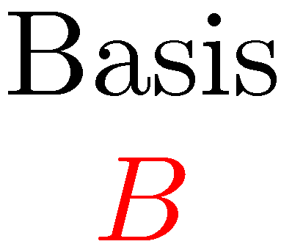
Vertices and policies

Slide 80
Lower bounds for Policy Iteration
Switch-All for Parity Games is exponential [Friedmann ’09]
Switch-All for MDPs is exponential [Fearnley ’10]
Random-Facet for Parity Games is sub-exponential [Friedmann-Hansen-Z ’11]
Random-Facet and Random-Edge for MDPs and hence for LPs are sub-exponential [FHZ ’11]

Slide 81
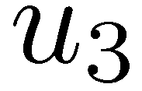
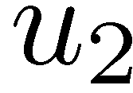
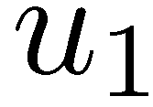
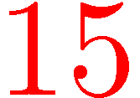
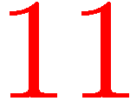
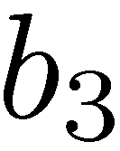
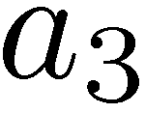
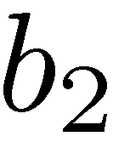
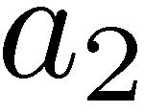
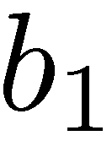
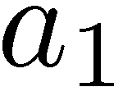
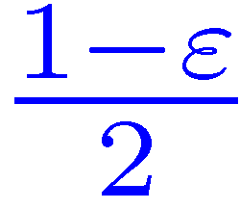
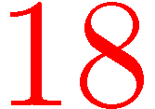
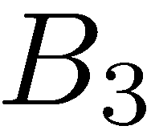
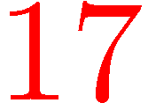
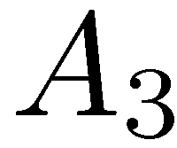
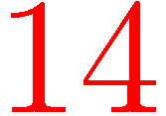
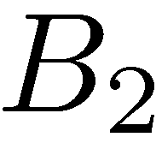
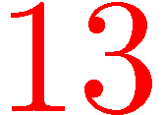
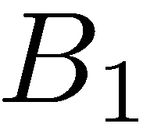
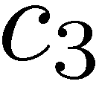
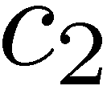
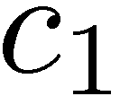
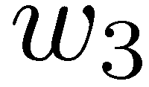
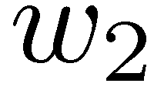
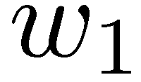
3-bit counter
(−N)¹⁵

Slide 82
3-bit counter
0
1
0

Slide 83
Observations
Five “decisions” in each level
Process always reaches the sink
Values are expected lengths of paths to sink

Slide 84
3-bit counter – Improving switches
Random-Edge can choose either one of these improving switches…
0
1
0

Slide 85
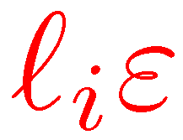
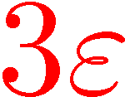
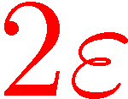
Cycle gadgets
Cycles close one edge at a time
Shorter cycles close faster

Slide 86
Cycle gadgets
Cycles open “simultaneously”

Slide 87
3-bit counter 2→3
0
1
1
0

Slide 88
From b to b+1 in seven phases
B_{k}-cycle closes
C_{k}-cycle closes
U-lane realigns
A_{i}-cycles and B_{i}-cycles for i<k open
A_{k}-cycle closes
W-lane realigns
C_{i}-cycles of 0-bits open

Slide 89
3-bit counter 3→4
0
1
1

Slide 90
Size of cycles
Various cycles and lanes compete with each other
Some are trying to open while some are trying to close
We need to make sure that our candidates win!
Length of all A-cycles = 8n
Length of all C-cycles = 22n
Length of B_{i}-cycles = 25i²n
O(n⁴) vertices for an n-bit counter
Can be improved using a more complicated construction and an improved analysis (work in progress)

Slide 91
Lower bound for Random-Facet
Implement a randomized counter

Slide 92
Related results
Sub-exponential lower bound for Zadeh’s pivoting rule [Friedmann ’10]
Dantzig’s pivoting rule, and the standard policy iteration algorithm, Switch-All, are polynomial for discounted MDPs, with a fixed discount factor [Ye ’10]
Switch-All is almost linear for discounted MDPs and discounted turn-based 2-player Stochastic Games, with a fixed discount factor [Hansen-Miltersen-Z ’11]

Slide 93
Many intriguing and important open problems …
Polynomial Policy Iteration Algorithms ???
Polynomial algorithms for
AUSOs ?
SPGs ?
MPGs ?
PGs ?
Strongly Polynomial algorithms for
MDPs ?

