Slide 1
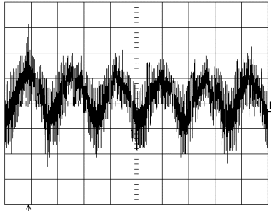
Learning Parities with Structured Noise
Sanjeev Arora, Rong Ge
Princeton University

Slide 2
Learning Parities with Noise
Secret u = (1,0,1,1,1)
u ∙ (0,1,0,1,1) = 0
u ∙ (1,1,1,0,1) = 1
u ∙ (0,1,1,1,0) = 1

Slide 3
Learning Parities with Noise
Secret vector u
Oracle returns random a and u∙a
u∙a is incorrect with probability p
Best known algorithm: 2^{O(n/log n)}
Used in designing public-key crypto

Slide 4
Learning Parities with Structured Noise
Secret u = (1,0,1,1,1)
u ∙ (0,1,0,1,1) = 0
u ∙ (1,1,0,1,0) = 1
u ∙ (0,1,1,0,0) = 1

Slide 5
Learning Parities with Structured Noise
Secret vector u
Oracle returns random a¹, a², …, a^{m} and b₁=u∙a¹, b₂=u∙a², …, b_{m}=u∙a^{m}
“Not all inner-products are incorrect”
The error has a certain structure
Can the secret be learned in polynomial time?

Slide 6
Structures as Polynomials
c_{i}=1 iff i-th inner-product is incorrect
P(c) = 0 if an answer pattern is allowed
“At least one of the inner-products is correct”
P(c) = c₁c₂c₃…c_{m} = 0
“No 3 consecutive wrong inner-products”
P(c) = c₁c₂c₃+c₂c₃c₄+…+c_{m-2}c_{m-1}c_{m} = 0

Slide 7
Notations
Subscripts are used for indexing vectors
u_{i}, c_{i}
Superscripts are used for a list of vectors
a^{i}
High dimensional vectors are indexed like Z_{i,j,k}
a, b are known constants, u, c are unknown constants used in analysis, x, y, Z are variables in equations.

Slide 8
Main Result
For ANY non-trivial structure P of degree d, the secret can be learned using n^{O(d)} queries and n^{O(d)} time.

Slide 9
Proof Outline
Linearization
Change View
Linear Equations
Unique Solution
Answers from Oracle

Slide 10
Linearization
c₁c₂c₃ = 0
c_{i} = b_{i}+a^{i}∙x
(a¹∙x+b₁)(a²∙x+b₂)(a³∙x+b₃) = 0 (*)
y₁ = x₁, y₂=x₂,…, y_{1,2} = x₁x₂,…, y_{1,2,3}=x₁x₂x₃
a¹₁a²₂a³₃y_{1,2,3}+…+b₁b₂b₃ = 0 (**)
Observation
y₁=u₁,y₂=u₂,…,y_{1,2,3}=u₁u₂u₃ always satisfies the equation (**)
Call it the Canonical solution
Coming Up
Prove when we have enough equations, this is the only possible solution.
Linear Equations of y Variables
(**) = L((*))

Slide 11
Form of the Linear Equation
Let Z³_{i,j,k} = L((x_{i}+u_{i})(x_{j}+u_{j})(x_{k}+u_{k}))
Z³_{1,2,3} = y_{1,2,3}+u₁y_{2,3}+u₂y_{1,3}+u₃y_{1,2}+u₁u₂y₃+ u₁u₃y₂+u₁u₂y₃+u₁u₂u₃
When c₁=c₂=c₃ = 0
Recall (a¹∙x+b₁)(a²∙x+b₂)(a³∙x+b₃) = 0 (*)
(a¹∙(x+u)+c₁)(a²∙(x+u)+c₂)(a³∙(x+u)+c₃) = 0

Slide 12
Change View
Linear Equation over y variables
Polynomial over a’s
Lemma
When Z³≠0, the equation is a non-zero polynomial over a’s
Schwartz-Zippel
The polynomial is non-zero w.p. at least 2^{-d}

Slide 13
Main Lemma ➔ Theorem
Non-Canonical Solution
Non-zero Z³ vector, Poly(a) = 0 for all equations
Schwartz-Zippel
Low Probability
Union Bound
No Non-Canonical Solutions
With High Probability

Slide 14
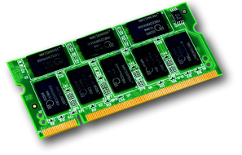
Learning With Errors
Used in designing new crypto systems
Resistant to “side channel attacks”
Provable reduction from worst case lattice problems

Slide 15
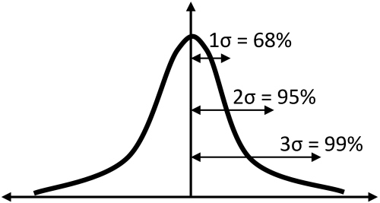
Learning With Errors
Secret u in Z_{q}^{n}
Oracle returns random a and a∙u+c
c is chosen from Discrete Gaussian distribution with standard deviation δ
When δ = Ω(n^{1/2}) lattice problems can be reduced to LWE

Slide 16
Learning With Structured Errors
Represent structures using polynomials
Thm: When the polynomial has degree d < q/4, the secret can be learned in n^{O(d)} time.
Cor: When δ = o(n^{1/2}), LWE has a sub-exponential time algorithm

Slide 17
Learning With Structured Errors
Take structure to be |c| < Cδ²
# of equations required = exp(O(Cδ²))
Probability that the structure is violated by a random answer (LWE oracle) = exp(-O(C²δ²))
LWE oracle ≈ LWSE oracle
With high probability the oracle answers satisfy the structure, the algorithm succeeds in finding the secret in time exp(O(δ²)) = exp(o(n)) when δ² = o(n).

Slide 18
Open Problems
Can linearization techniques provide a non-trivial algorithm for the original model?
Are there more applications by choosing appropriate patterns?
Is it possible to improve the algorithm for learning with errors?

Slide 19
Thank You
Questions?

Slide 20
Adversarial Noise
Structure = “not all inner-products are incorrect”
Secret u = (1,0,1,1,1)
Pretend (0,1,1,0,0)
u ∙ (0,1,0,1,1) = 0 1 1
u ∙ (1,1,0,1,0) = 0 0 1
u ∙ (0,1,1,0,0) = 1 1 0

Slide 21
Adversarial Noise
The adversary can fool ANY algorithm for some structures.
Thm: If there exists a vector c that cannot be represented as c = c¹+c², P(c¹)=P(c²)=0, then the secret can be learned using n^{O(d)} queries in n^{O(d)} time, otherwise no algorithm can learn the secret with probability > 1/2

