Slide 1
New Balanced Search Trees
Siddhartha Sen
Princeton University
Joint work with Bernhard Haeupler and Robert E. Tarjan

Slide 2
Research Agenda
Elegant solutions to fundamental problems
  Systematically explore the design space
  Keep design simple, allow complexity in analysis
Theoretical justification for elegant solutions
  Look at what people do in practice

Slide 3
Searching: Dictionary Problem
Maintain a set of items, so that
  Access: find a given item
  Insert: add a new item
  Delete: remove an item
are efficient
Assumption: items are totally ordered, binary comparison is possible

Slide 4
Balanced Search Trees
AVL trees
red-black trees
weight balanced trees
LLRB trees, AA trees
2,3 trees
B trees
etc.
binary
multiway

Slide 5
Agenda
Rank-balanced trees [WADS 2009]
  Proof technique
Ravl trees [SODA 2010]
  Proofs
Experiments

Slide 6
Problem with BSTs: Imbalance
How to bound height?
  Maintain local balance condition, rebalance after insert/delete balanced tree
  Restructure after each access self-adjusting tree
a
b
c
d
e
f

Slide 7
Problem with BSTs: Imbalance
How to bound height?
  Maintain local balance condition, rebalance after insert/delete balanced tree
  Restructure after each access self-adjusting tree
Store balance information in nodes, rebalance bottom-up (or top-down)
  Update balance information
  Restructure along access path
a
b
c
d
e
f

Slide 8
Restructuring primitive: Rotation
y
x
right
left
x
C
A
y
A
B
B
C
Preserves symmetric order
Changes heights
Takes O(1) time
Notes:
8

Slide 9
Known Balanced BSTs
small height
little rebalancing
AVL trees
red-black trees
weight balanced trees
LLRB trees, AA trees
etc.
Goal: small height, little rebalancing, simple algorithms

Slide 10
Ranked Binary Trees
Each node has integer rank
  Convention: leaves have rank 0, missing nodes have rank -1
rank difference of child =
rank of parent − rank of child
i-child: node of rank difference i
i,j-node: children have rank differences i and j
Estimate for height

Slide 11
Example of a ranked binary tree
2
d
1
b
1
1
e
1
0
a
1
0
c
1
0
f
1
If all rank differences positive, rank ≥ height

Slide 12
Rank-Balanced Trees
AVL trees: every node is a 1,1- or 1,2-node
Rank-balanced trees: every node is a 1,1-, 1,2-, or 2,2-node (rank differences are 1 or 2)
Red-black trees: all rank differences are 0 or 1, no 0-child is the parent of another
All need one balance bit per node

Slide 13
Basic height bounds
n_{k} = minimum n for rank k
Rank-balanced trees:
n₀ = 1, n₁ = 2, n_{k} = 2n_{k-2} + 1,
n_{k} = 2 ^{⎡k/2⎤} ⇒ k ≤ 2lg n
Red-black trees: same
AVL trees: k ≤ log_{φ} n ≈ 1.44lg n
φ = (1 + √5)/2

Slide 14
Rank-Balanced Trees
height ≤ 2lg n
2 rotations per rebalancing
O(1) amortized rebalancing time
Red-Black Trees
height ≤ 2lg n
3 rotations per rebalancing
O(1) amortized rebalancing time

Slide 15
Rank-Balanced Trees
height ≤ min{2lg n, log_{φ} m}
2 rotations per rebalancing
O(1) amortized rebalancing time
Red-Black Trees
height ≤ 2lg n
3 rotations per rebalancing
O(1) amortized rebalancing time
I win

Slide 16
Tree Height
Theorem. A rank-balanced tree built by m insertions intermixed with arbitrary deletions has height at most log_{φ} m.
If m = n, same height as AVL trees
Overall height is min{2lg n, log_{φ} m}

Slide 17
Rebalancing Frequency
Theorem. In a rank-balanced tree built by m insertions and d deletions, the number of rebalancing steps of rank k is at most O((m + d)/2^{k/3}).
Exponentially better than O((m + d)/k)
Good for concurrent workloads
Similar result for red-black trees (b = 2^{1/2})

Slide 18
Exponential analysis
Exploit exponential structure of tree
… use an exponential potential function!

Slide 19
Proof idea: Define potential of node of rank k
b^{k ± c}
where b = fixed constant, c depends on node
Insertion/deletion increases potential by ≤ O(1), so total potential ≤ O(m)
Choose c so that potential change during rebalancing telescopes ⇒ no net increase

Slide 20
Show that rebalancing step of rank k reduces potential by b^{k ± c}
  At root, happens automatically
  At non-root, need to truncate potential function
Tree height:
Σb^{k ± c} ≤ O(m) ⇒ k ≤ log_{b} m ± c
Rebalancing frequency:
Σb^{k ± c} ≤ O(m) ⇒ Σ ≤ m/(b^{k ± c})

Slide 21
Summary
Rank-balanced trees achieve AVL-type height bound, exponentially infrequent rebalancing
Exponential analysis yields new insights into efficiency of rebalancing
  Bounds in terms of m only, not n…
Can we exploit this flexibility?

Slide 22
Where’s the pain?
AVL trees
rank-balanced trees
red-black trees
weight balanced trees
LLRB trees, AA trees
2,3 trees
B trees
etc.
Common problem: Deletion is a pain!
binary
multiway

Slide 23
Deletion is problematic
More complicated than insertion
May need to swap item with successor/ predecessor
Synchronization reduces available parallelism [Gray and Reuter]

Slide 24
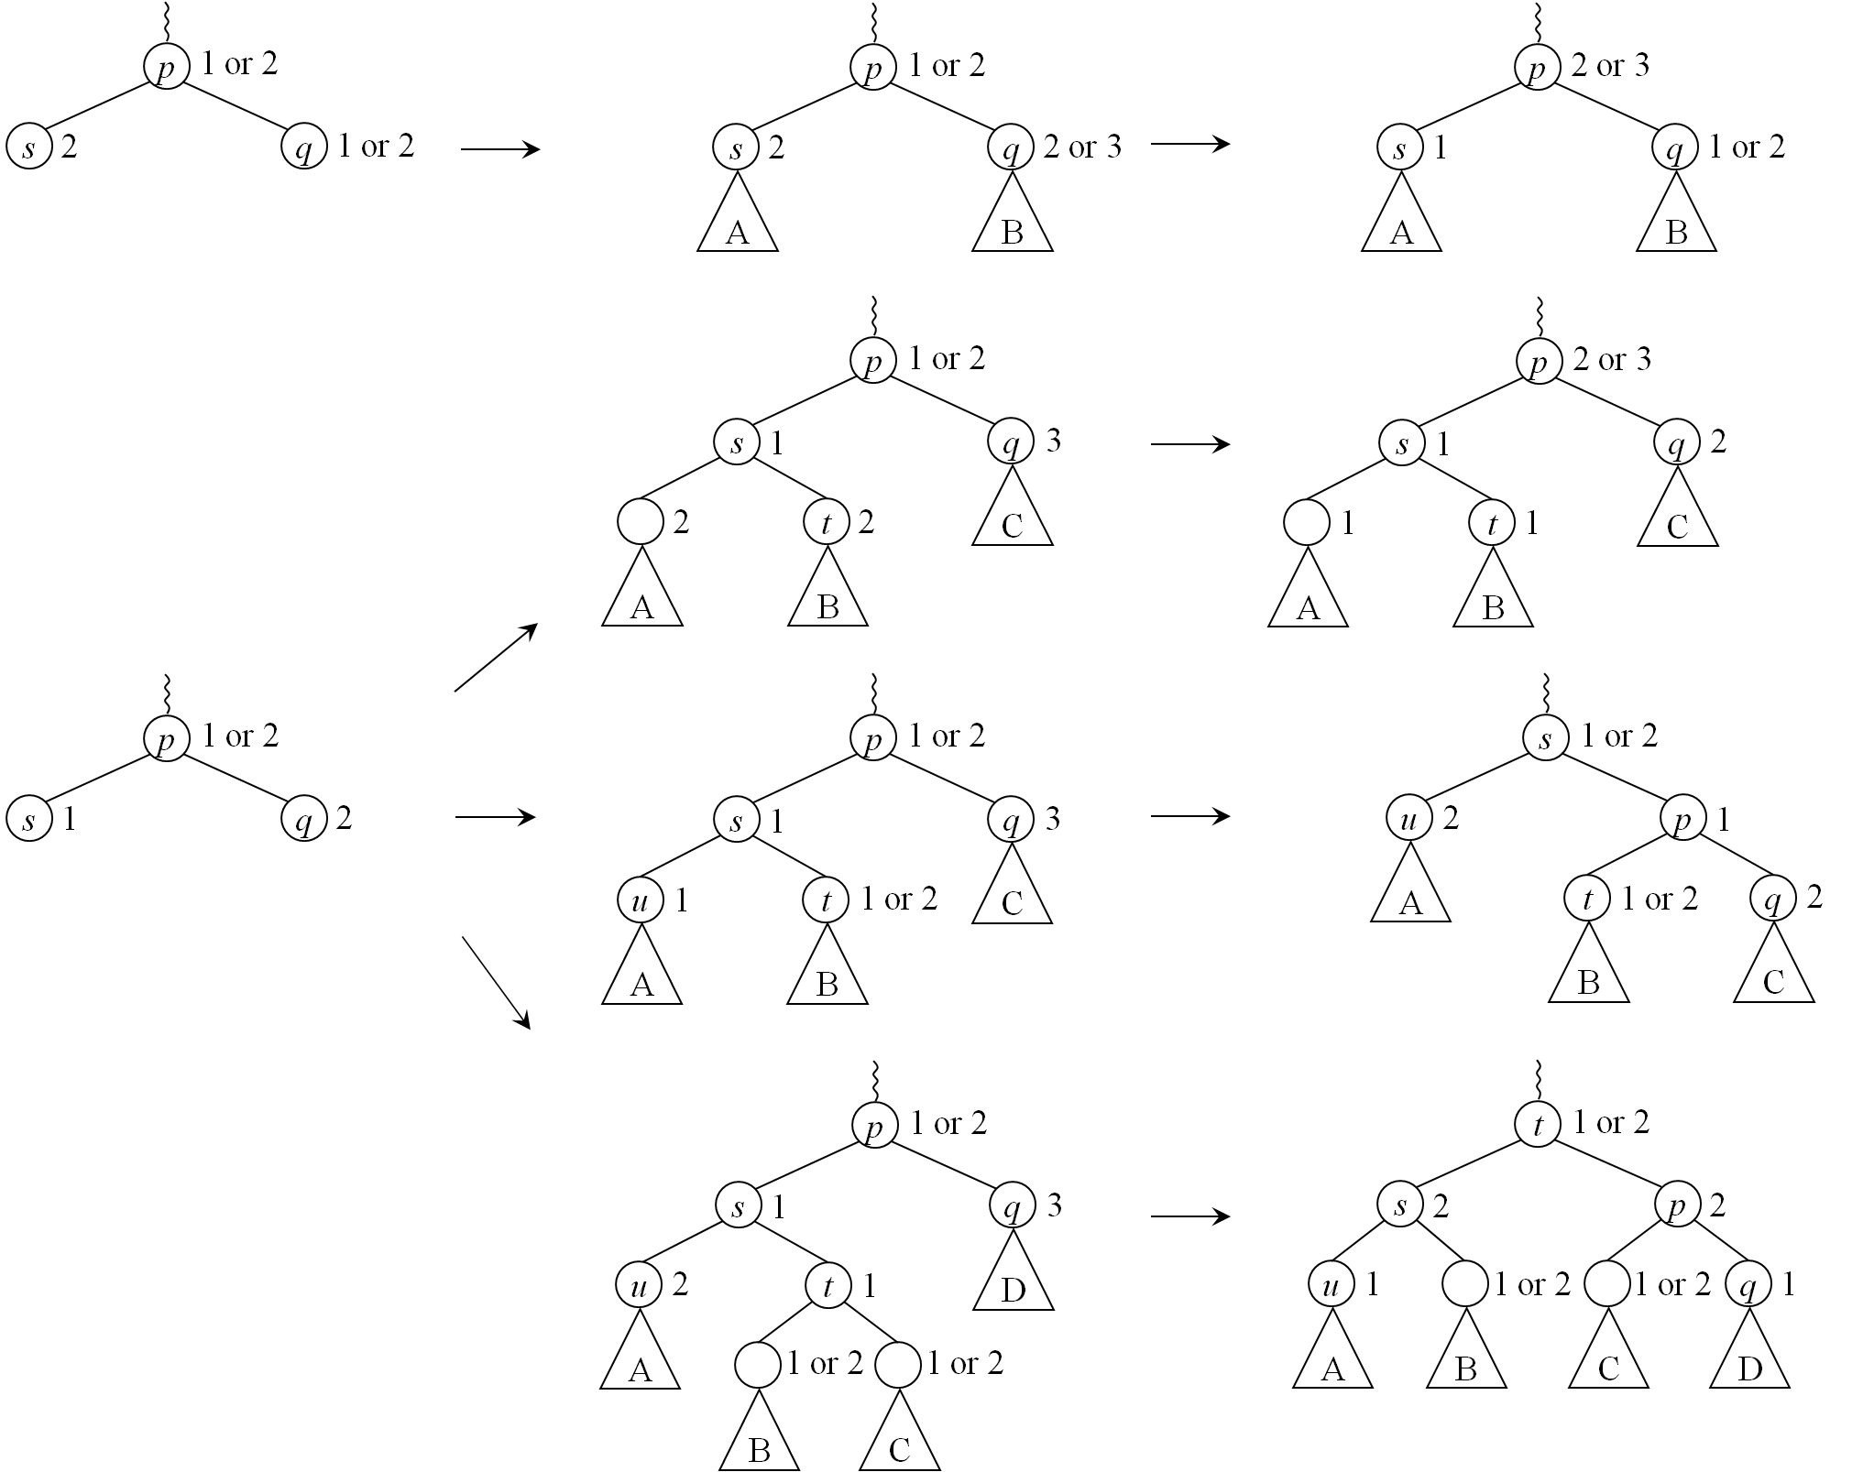
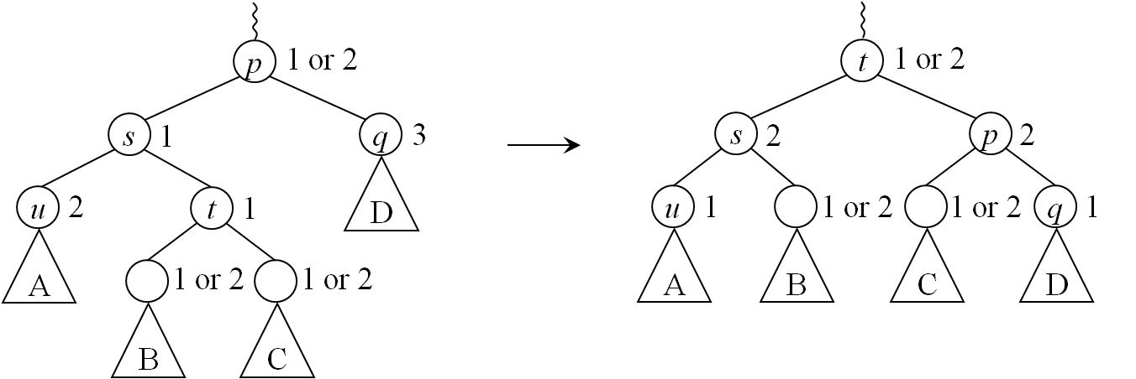
Example: Rank-balanced trees
Non-terminal
Synchronization ☹

Slide 25
Solutions?
Don’t discuss it!
  Textbooks
Don’t do it!
  Berkeley DB and other database systems
  Unnamed database provider…

Slide 26
Deletion Without Rebalancing
Good idea?
Yes for B+ trees (database systems), based on empirical and average-case analysis
How about binary trees?
  Failed miserably in real app with red-black trees

Slide 27
Deletion Without Rebalancing
Yes! Can apply exponential analysis:
  Height logarithmic in m, number of insertions
  Rebalancing exponentially infrequent in height
Binary trees: use Ω(loglog m) bits of balance information per node
  Red-black, AVL, rank-balanced trees use only one bit
Similar results hold for B⁺ trees, easier [ISAAC 2009]

Slide 28
Ravl Trees
AVL trees: every node is a 1,1- or 1,2-node
Rank-balanced trees: every node is a 1,1-, 1,2-, or 2,2-node (rank differences are 1 or 2)
Red-black trees: all rank differences are 0 or 1, no 0-child is the parent of another
Ravl trees: every rank difference is positive
  Any tree is a ravl tree; efficiency comes from design of operations

Slide 29
Ravl trees: Insertion
A new leaf q has a rank of zero
If the parent p of q was a leaf before, q is a 0-child and violates the rank rule

Slide 30
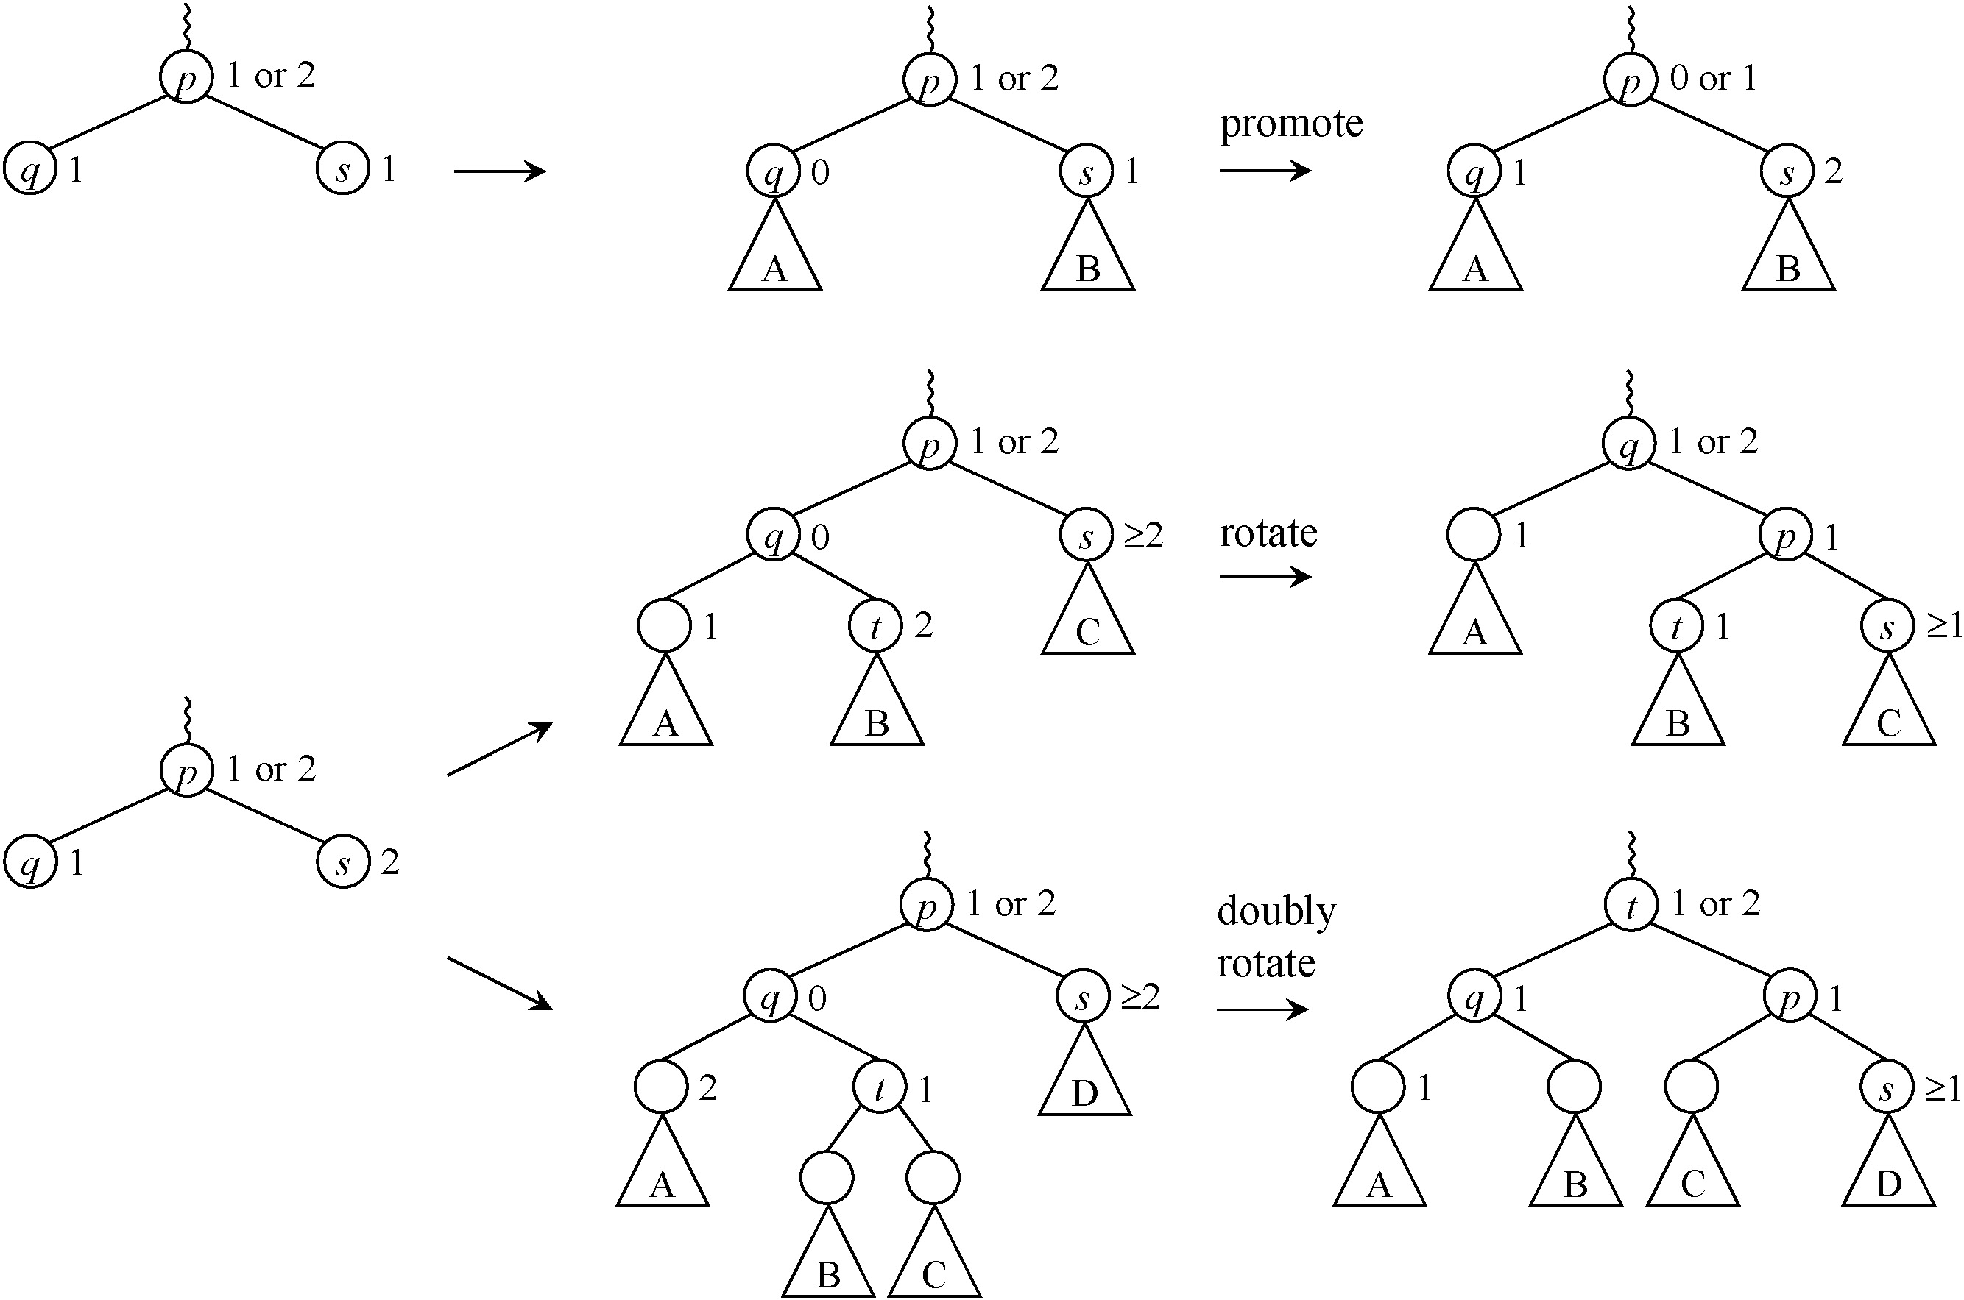
Insertion Rebalancing
Non-terminal
Same as rank-balanced trees, AVL trees

Slide 31
Ravl trees: Deletion
☺
If node has two children, swap with symmetric-order successor or predecessor

Slide 32
Example
Demote b
2
b
>
a
d
Rotate left at d
2
1
1
Promote d
0
2
0
>
c
2
e
Promote e
1
0
0
1
1
0
>
0
f
1
Insert f
0
Notes:
32

Slide 33
Example
2
d
1
b
1
1
e
1
0
a
1
0
c
1
0
f
1
Insert f
Notes:
33

Slide 34
Example
e
2
d
Swap with successor
b
d
f
1
1
0
e
1
Delete
1
2
0
a
1
0
c
1
0
f
1
Delete f
Delete d
Delete a
Notes:
34

Slide 35
Example
2
e
>
1
b
1
0
g
2
0
c
1
Insert g
Notes:
35

Slide 36
Tree Height
Theorem 1. A ravl tree built by m insertions intermixed with arbitrary deletions has height at most log_{φ} m.
Compared to standard AVL trees:
  If m = n, height is same
  If m = O(n), height within additive constant
  If m = poly(n), height within constant factor

Slide 37
Proof. Let F_{k} be k^{th} Fibonacci number. Define potential of node of rank k:
F_{k+2} if 0,1-node
F_{k+1} if not 0,1-node but has 0-child
F_{k} if 1,1 node
Zero otherwise
Potential of tree = sum of potentials of nodes
Recall: F₀ = 1, F₁ = 1, F_{k} = F_{k−1} + F_{k−2} for k > 1
F_{k+2} > φ^{k}

Slide 38
Proof. Let F_{k} be k^{th} Fibonacci number. Define potential of node of rank k:
F_{k+2} if 0,1-node
F_{k+1} if not 0,1-node but has 0-child
F_{k} if 1,1 node
Zero otherwise
Deletion does not increase potential
Insertion increases potential by ≤ 1, so total potential ≤ m − 1
Rebalancing steps don’t increase potential

Slide 39
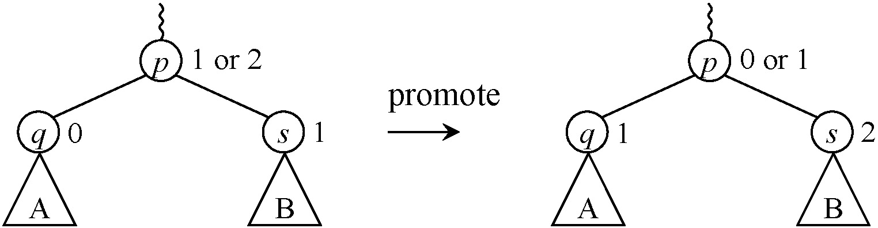
Consider rebalancing step of rank k:
F_{k+1} + F_{k+2} F_{k+3} + 0
0 + F_{k+2} F_{k+2} + 0
F_{k+2} + 0 0 + 0

Slide 40
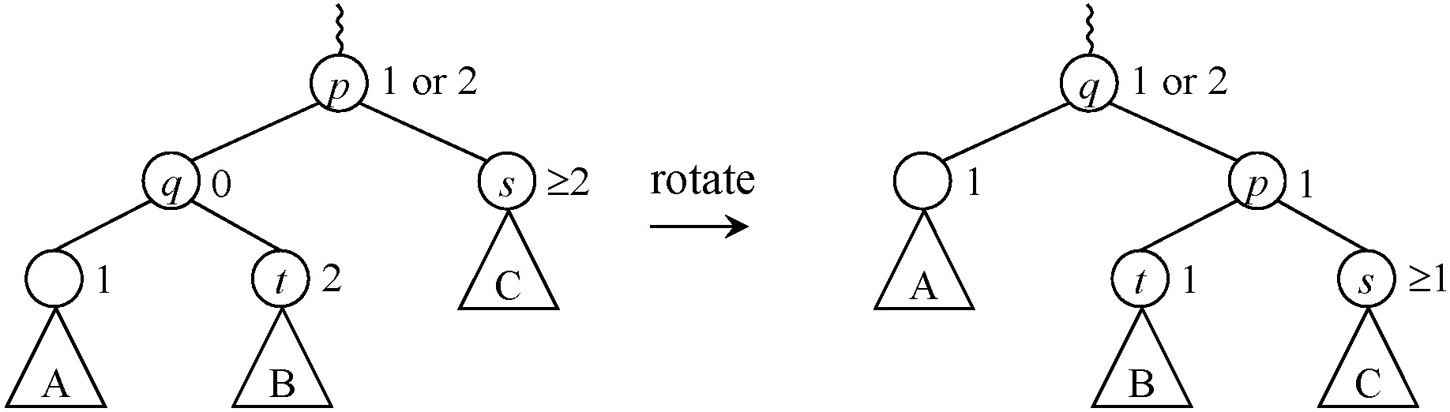
Consider rebalancing step of rank k:
F_{k+1} + 0 F_{k} + F_{k-1}

Slide 41
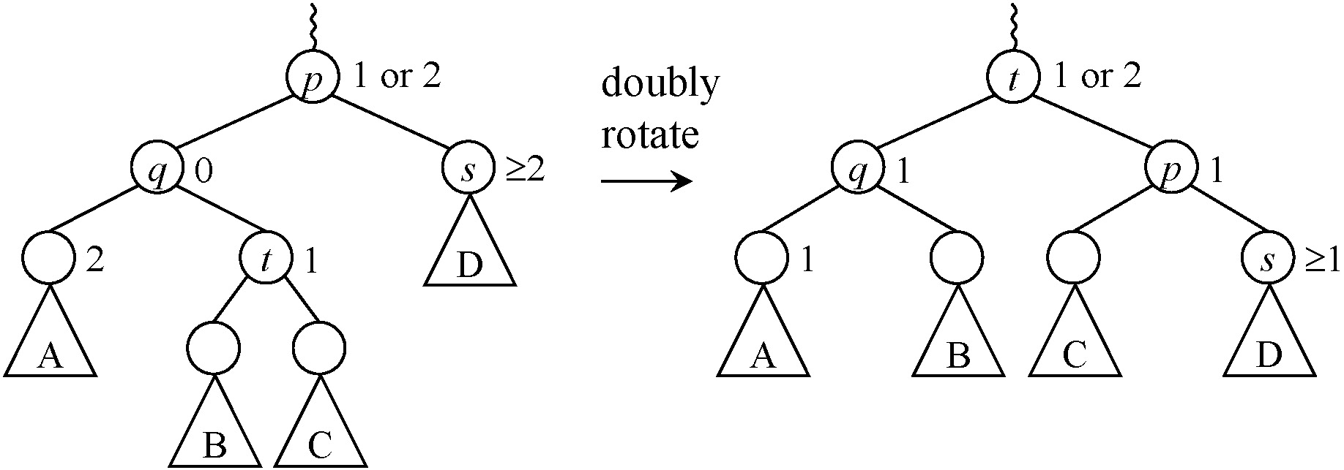
Consider rebalancing step of rank k:
F_{k+1} + 0 + 0 F_{k} + F_{k-1} + 0

Slide 42
If rank of root is r, then increase of rank k did not create 1,1-node for 0 < k < r − 1
Total decrease in potential:
Since potential always non-negative:

Slide 43
Rebalancing Frequency
Theorem 2. In a ravl tree built by m insertions intermixed with arbitrary deletions, the number of rebalancing steps of rank k is at most
⇒ O(1) amortized rebalancing steps

Slide 44
Proof. Truncate potential function:
Nodes of rank < k have same potential
Nodes of rank ≥ k have zero potential
(one exception for rank = k)
Step of rank k reduces potential by:
F_{k+1}, or
F_{k+1} − F_{k−1} = F_{k}
At most (m − 1)/F_{k} such steps

Slide 45
Disadvantage of Ravl Trees?
Tree height may be ω(log n)
Only happens when deletions/insertions ratio approaches 1, but may be concern for some apps
Periodically rebuild tree

Slide 46
Periodic Rebuilding
Rebuild tree (all at once or incrementally) when rank r of root too high
Rebuild when r > log_{φ} n + c for fixed c > 0:
  O(1/(φ^{c} − 1)) rebuilding time per deletion
Tree height always log_{φ} n + O(1)

Slide 47
Summary
Exponential analysis gives good worst-case properties of deletion without rebalancing
  Logarithmic height bound in m
  Exponentially infrequent node updates
Periodic rebuilding keeps height logarithmic in n

Slide 48
Open problems
Binary trees require Ω(loglog n) balance bits per node?
Other applications of exponential analysis?
  Average-case behavior

Slide 49
Teach rank-balanced trees and ravl trees!

Slide 50
Experiments

Slide 51
Preliminary Experiments
Compared three trees with O(1) amortized rebalancing time
  Red-black trees
  Rank-balanced trees
  Ravl trees
Performance in practice depends on workload!

Slide 52
Preliminary Experiments
Test | Red-black trees |  |  |  | Rank-balanced trees |  |  |  | Ravl trees
 | # rots × 10⁶ | # bals × 10⁶ | avg. pLen | max. pLen | # rots × 10⁶ | # bals × 10⁶ | avg. pLen | max. pLen | # rots × 10⁶ | # bals × 10⁶ | avg. pLen | max. pLen
Random | 26.44 | 116.07 | 10.47 | 15.63 | 29.55 | 133.74 | 10.39 | 15.09 | 14.32 | 80.61 | 11.11 | 16.75
Queue | 50.32 | 285.13 | 11.38 | 22.50 | 50.33 | 184.53 | 11.20 | 14.00 | 33.55 | 134.22 | 11.38 | 14.00
Working set | 41.71 | 185.35 | 10.51 | 16.18 | 43.69 | 159.69 | 10.45 | 15.35 | 28.00 | 119.92 | 11.20 | 16.64
Static Zipf | 25.24 | 112.86 | 10.41 | 15.46 | 28.27 | 130.93 | 10.34 | 15.05 | 13.48 | 78.03 | 11.12 | 17.68
Dynamic Zipf | 23.18 | 103.48 | 10.48 | 15.66 | 26.04 | 125.99 | 10.40 | 15.16 | 12.66 | 74.28 | 11.11 | 16.84
2¹³ nodes, 2²⁶ operations
No periodic rebuilding in ravl trees

Slide 53
Preliminary Experiments
Test | Red-black trees |  |  |  | Rank-balanced trees |  |  |  | Ravl trees
 | # rots × 10⁶ | # bals × 10⁶ | avg. pLen | max. pLen | # rots × 10⁶ | # bals × 10⁶ | avg. pLen | max. pLen | # rots × 10⁶ | # bals × 10⁶ | avg. pLen | max. pLen
Random | 26.44 | 116.07 | 10.47 | 15.63 | 29.55 | 133.74 | 10.39 | 15.09 | 14.32 | 80.61 | 11.11 | 16.75
Queue | 50.32 | 285.13 | 11.38 | 22.50 | 50.33 | 184.53 | 11.20 | 14.00 | 33.55 | 134.22 | 11.38 | 14.00
Working set | 41.71 | 185.35 | 10.51 | 16.18 | 43.69 | 159.69 | 10.45 | 15.35 | 28.00 | 119.92 | 11.20 | 16.64
Static Zipf | 25.24 | 112.86 | 10.41 | 15.46 | 28.27 | 130.93 | 10.34 | 15.05 | 13.48 | 78.03 | 11.12 | 17.68
Dynamic Zipf | 23.18 | 103.48 | 10.48 | 15.66 | 26.04 | 125.99 | 10.40 | 15.16 | 12.66 | 74.28 | 11.11 | 16.84
rank-balanced: 8.2% more rots, 0.77% more bals
ravl: 42% fewer rots, 35% fewer bals

Slide 54
Preliminary Experiments
Test | Red-black trees |  |  |  | Rank-balanced trees |  |  |  | Ravl trees
 | # rots × 10⁶ | # bals × 10⁶ | avg. pLen | max. pLen | # rots × 10⁶ | # bals × 10⁶ | avg. pLen | max. pLen | # rots × 10⁶ | # bals × 10⁶ | avg. pLen | max. pLen
Random | 26.44 | 116.07 | 10.47 | 15.63 | 29.55 | 133.74 | 10.39 | 15.09 | 14.32 | 80.61 | 11.11 | 16.75
Queue | 50.32 | 285.13 | 11.38 | 22.50 | 50.33 | 184.53 | 11.20 | 14.00 | 33.55 | 134.22 | 11.38 | 14.00
Working set | 41.71 | 185.35 | 10.51 | 16.18 | 43.69 | 159.69 | 10.45 | 15.35 | 28.00 | 119.92 | 11.20 | 16.64
Static Zipf | 25.24 | 112.86 | 10.41 | 15.46 | 28.27 | 130.93 | 10.34 | 15.05 | 13.48 | 78.03 | 11.12 | 17.68
Dynamic Zipf | 23.18 | 103.48 | 10.48 | 15.66 | 26.04 | 125.99 | 10.40 | 15.16 | 12.66 | 74.28 | 11.11 | 16.84
rank-balanced: 0.87% shorter apl, 10% shorter mpl
ravl: 5.6% longer apl, 4.3% longer mpl

