Slide 1
Trevisan’s extractor in the presence of quantum side information
Thomas Vidick
UC Berkeley
Joint work with Anindya De
Notes:
Give a little bit of motivation for studying quantum states; overview

Slide 2
Geometry of quantum states
n-qubit state = 2^{n}-dim. complex unit vector $v$
Measurement = ON basis $\left\{e_{i}\right\}$
$\text{Prob}(“i”)={|v∙e_{i}|}^{2}$
State $v$ projected to $u_{i}$ after measurement
Generalized meas: any $\left\{e_{i}\right\}$ s.t. for all $v$, $Σ_{i} {|v∙e_{i}|}^{2}$ =1
Information content?
Infinite precision…
≈2^{n} degrees of freedom
How much of it can be accessed?
Measuring collapses the state
Many choices of basis!
$$v$$
$$v′$$
Notes:
explain what measurement can do, if needed
Any measurement can give at most n bits of information
But until we decide on a measurement, a wealth of information is potentially there

Slide 3
Example: 2$→$1 RAC
Goal: map ${(b}_{0},b_{1}) ε {\left\{0,1\right\}}^{2}$ to $v ε \left\{0,1\right\}$ such that for any $i$, $x_{i}$ can be recovered from $v$ with prob. $p$
→ max. success $p=.5$
Quantum: $v ε ℂ^{2}$
→ success $p≈.85$!
1-qubit quantum state
provides better encoding
than any 1-bit encoding
$$v_{11}$$
$$e_{1}$$
$$v_{10}$$
$$f_{1}$$
$$f_{0}$$
$$v_{01}$$
$$v_{00}$$
$$e_{0}$$
$e_{i}$: first bit
$f_{i}$: second bit

Slide 4
Context(s)
Tomography/Learning
Reconstruct state from measurements
Usually, only want to reproduce small set of measurements
[Aar,Dru]: Succinct (but inefficient) classical description
Cryptography
Quantum computers break RSA
[Mau] A different assumption: adversary has bounded storage
→ Crypto without computational assumptions
Cannot rule out adversary with quantum storage
Communication complexity
Alice, Bob get classical inputs x,y
Exchange quantum messages to compute f(x,y) ϵ {0,1}
Exponential savings for relations and partial functions
Notes:
Learning: don’t need full information – would not make the difference in a lifetime anyways
Crypto: RSA; cannot avoid quantum adversary. motivate bounded storage assumption; even more so for quantum. Make clear cryptosystem stays classical.
CC: abstraction to study the phenomenon.

Slide 5
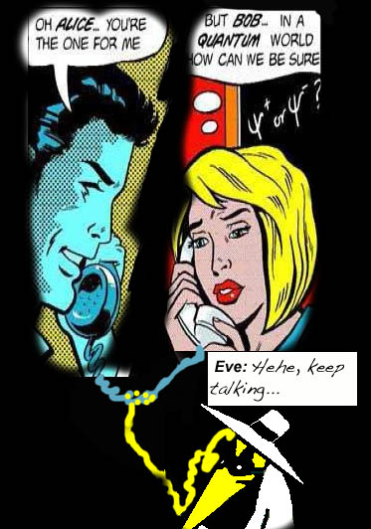
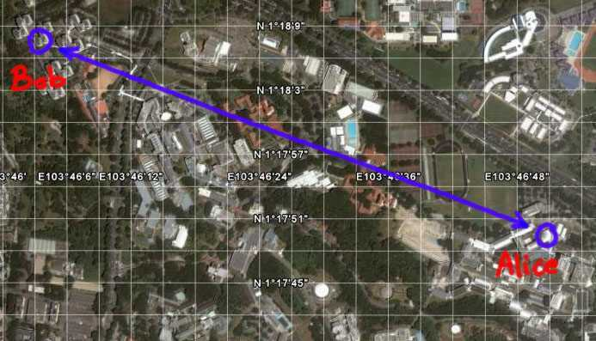
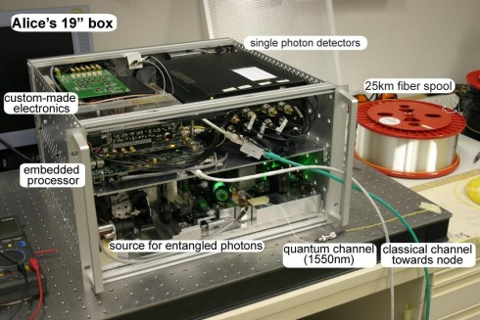
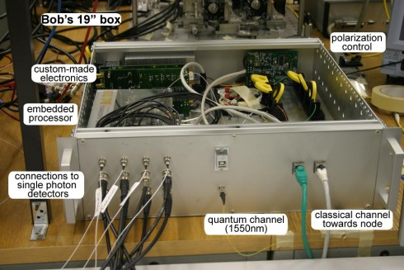
Quantum key distribution
Alice, Bob want to create a shared private key to do crypto
Alice sends polarized photons to Bob, who measures them → shared random string X
Adversary Eve could intercept some of the photons, and send junk back to Bob
Assumption: Alice and Bob can bound the amount of storage b Eve has kept. (They can compute a bound $H_{∞}\left( X \right|E )$ on her knowledge about X.)
Goal is to compute a perfectly (statistically) secret key
Alice selects a random function from some family and applies it to X
Tells Bob which function, so he can do the same.
Extractor: X + seed → key K
“secure” if adversary cannot distinguish K from uniform given his storage + key
Notes:
→ need to “amplify” the security of X

Slide 6
Some previous work
Best classically: extract $≈N−b$bits of key with $≈\log{N}$ seed
[GKKRW’07]: a (bad) extractor secure against $Ω\left(\sqrt{N}\right)$ classical storage but broken by $O(\log{N)}$quantum storage
[KMR’05]: 2-universal hashing works.
Seed length is $≈N$
[KT’06]: any classical 1-bit extractor is also secure against quantum adversaries
[T-S’09]: variant of Trevisan’s extractor, based on locally list-decodable codes
First construction to achieve logarithmic seed length
Weak output length ${\left(\frac{N}{b}\right)}^{1/15}$ (instead of optimal N-b)
Notes:
Interested in how much information rho_x can encode about Ext(x,y), for many y. Only one bit needed for any y
TS posed as a “challenge” at QIP to generalize his construction

Slide 7
Trevisan’s extractor
C a “good” code $\{0,1\}N→\{0,1\}N’, N’$= poly($N$)
Seed-expansion $g: \{0,1\}t→[N’]m, g(y)=(y1,…,ym)$
C
x
0
1
0
1
0
1
C(x)
1
0
0
1
1
1
0
y
g
1
0
Ext: $x,y→C(x)y1,…., C(x)ym$
[T’99]: output length $Ω(N−b)$with poly-log seed length
Many variations possible based on the choice of code and
seed-expansion function
Theorem [De-V.]
Also secure against quantum bounded-storage adversaries
Parameters are essentially same as classical
Notes:
Seed expansion comes from pseudo-random generator
still one of the best extractors around
We show that roughly the same parameters hold, even against quantum storage
Skip proof, but explain key step. Orally: adversary predicts one bit, but with very small success prob (eps/m), because of hybrid argument
but good code, so classically this is fine

Slide 8
Overview of security proof
By contradiction: assume adversary A can distinguish output from uniform with success ɛ.
First step: using A, construct an adversary A’ such that
A’ has access to the same side information as A
A’ has some additional classical information over m bits
A’ can predict $C(x)y$ with success prob. $½+ɛ/m$
Second step: prove lower bound on storage required
Classical proof reconstructs x from adversary’s storage
Cannot measure quantum states twice!
Adversary needs to distinguish two states: those which encode ${C(x)}_{y}=0$, and those for which ${C(x)}_{y}=1$
Known best way to distinguish two states (PGM)
Can relate the quant. adversary to a classical one [König-Terhal’06]
Notes:
First step crucially uses properties of pseudorandom generator, but same quantum as classical -> skip
Mention no-repeated-measurement is big problem. One approach used before (ta-shma) is to use locally list-decodable code: few queries->few measurements needed.

Slide 9
Optimally distinguishing quantum states
$$v_{11}$$
$$e_{1}$$
$$v_{10}$$
PGM $g$ almost as good as $e$…
… and also as $f$
→ By linearity, adversary
equivalent to measuring $g$,
then outputting 1st/2nd bit
→ Makes a single, fixed
meas.: cannot extract
more information than classical
adversary
$$f_{1}$$
$$f_{0}$$
$$g_{11}$$
$$g_{10}$$
$$v_{01}$$
$$v_{00}$$
$$g_{01}$$
$$g_{00}$$
$$e_{0}$$
Notes:
Key is linearity of measurement

Slide 10
Summary
Quantum states solve some encoding tasks much better than classical
Relevant in cryptography, where bounded storage is a common assumption
Eavesdropper encodes his view for later use
We show a very polyvalent extractor construction due to Trevisan secure against bounded-storage quantum adversaries
First construction known with poly-log seed and linear output length
By-product: obtain very strong lower bounds for many encodings $x→ρx$based on list-decodable codes, such as XOR code [ARW’08]
A wealth of other cryptographic primitives potentially break down in the presence of quantum adversaries…
Two-source extractors, condensers, OWF,…
Underlying question: when do quantum states hold more information than classical ones?

Slide 11
Thank you!

