Slide 1
Efficient Sampling Methods
for Discrete Distributions
Karl Bringmann
Max Planck Institute for Informatics, Saarbrücken
joint work with Konstantinos Panagiotou
August 14, 2012
FF: 18:11
all: 32:00
gekürzt: 26:00, 24:00 (28:00), 29:00

Slide 2
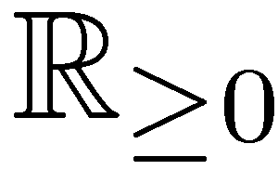
A Classic Sampling Problem
PropSampling:
universe:
{ 1, 2, 3, 4, …, n }
Given p₁,…,p_{n} 2 Sample s 2 {1,..,n} with
probabilities:
0.2 0.4 0.08 0.1 … 0.05
random
choice:
sampled
element s:
2
Applications in:
- (randomized algorithms)
- sampling random graphs
- efficient physical simulations

Slide 3
A Classic Sampling Problem
PropSampling:
universe:
{ 1, 2, 3, 4, …, n }
Given p₁,…,p_{n} 2 Sample s 2 {1,..,n} with
probabilities:
0.2 0.4 0.08 0.1 … 0.05
random
choice:
sampled
element s:
2
- O(n) preprocessing, O(1) query time
[Walker’77]
- this is optimal:
- consider instances of the form p = (0,..,0,1,0,..,0)
- sampling means finding the 1
- searching in an unordered array takes time Ω(n)

Slide 4
A Classic Sampling Problem
PropSampling:
universe:
{ 1, 2, 3, 4, …, n }
Given p₁,…,p_{n} 2 Sample s 2 {1,..,n} with
probabilities:
0.2 0.4 0.08 0.1 … 0.05
random
choice:
sampled
element s:
2
- O(n) preprocessing, O(1) query time
[Walker’77]
- builds data structure of size £(n) cells = £(n log n) bits
- dynamic version: O(1) update time
[Hagerup,Mehlhorn,Munro’93]
[Matias,Vitter,Ni’03]

Slide 5
Outline – 3 Questions
1. Can we use less space?
2. Can we be faster on restricted inputs? (sorted inputs)
3. Can we solve a more general problem? (sampling subsets)

Slide 6
1. Question
Can we use less space?
- classic algorithm needs £(n) additional cells = £(n log n) additional bits
Theorem:
PropSampling can be solved with O(n) preprocessing and O(1) expected query time…
Answer 1:
Answer 2:
… inplace using
O(log n) additional cells.
… using ²n additional bits for any ²>0.
- inplace with O(n log n) preprocessing:
- sort p₁,…,p_{n} and use our algo for sorted inputs
- inplace with O(n) preprocessing: “roughly” sort p₁,…,p_{n}

Slide 7
A New Simple Algo for PropSampling
- O(n) preprocessing:
- normalize s.t. §_{i} p_{i} = n
- build sorted array containing 1..n:
A:
1
1
2
2
2
3
4
4
5
- i appears bp_{i}c+1 times
- O(1) expected query time:
1. pick random k 2 {1,…,|A|}
- Pr[returning i]
~bp_{i}c+{p_{i}} = p_{i}
2. (rejection): if k is first occurrence of A[k]:
- A has ·2n entries
with probability 1-{p_{A[k]}}: goto 1.
3. return A[k]
- Pr[leaving loop] ¸ 1/2

Slide 8
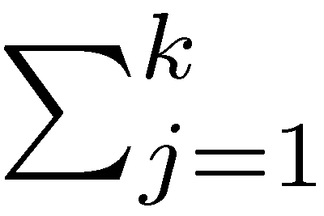
Few Additional Bits
A:
1
1
2
2
2
3
4
4
5
B:
1
0
1
0
0
1
1
0
1
1 starts
2 starts
3 starts …
- Rank_{B}(k) := B[j]
- Rank_{B}(k) = A[k]
- Rank queries can be answered in O(1) time using a data
structure of size (1+o(1))|B| bits
[Jacobson’89]
- in our case: O(n) bits
- consider blocks of 1/² p_{i}‘s to reduce space to ²n bits and
increase query time to O(1/²)
- matching lower bound?

Slide 9
1. Question
Can we use less space?
- classic algorithm needs £(n) additional cells = £(n log n) additional bits
Theorem:
PropSampling can be solved with O(n) preprocessing and O(1) expected query time…
Answer 1:
Answer 2:
… inplace using
O(log n) additional cells.
… using ²n additional bits for any ²>0.
- inplace with O(n log n) preprocessing:
- sort p₁,…,p_{n} and use our algo for sorted inputs
- inplace with O(n) preprocessing: “roughly” sort p₁,…,p_{n}

Slide 10
2. Question
Can we be faster on restricted inputs?
Theorem:
SortedPropSampling (where p₁ ¸…¸ p_{n}) can be sampled with
O(log n) preprocessing
O(1) expected query time
- input: access to n and each p_{i} in unit time,
- e.g. p_{i}’s in an array,
- or p_{i}’s computable in O(1) time
- we have the guarantee that the input is sorted

Slide 11
2. Question
Can we be faster on restricted inputs?
Theorem:
SortedPropSampling (where p₁ ¸…¸ p_{n}) can be sampled with
O(log n) preprocessing
O(1) expected query time
more general inputs:
- a sorted upper bound
- unimodal probabilities
- approximation schemes
for the p_{i} suffice

Slide 12
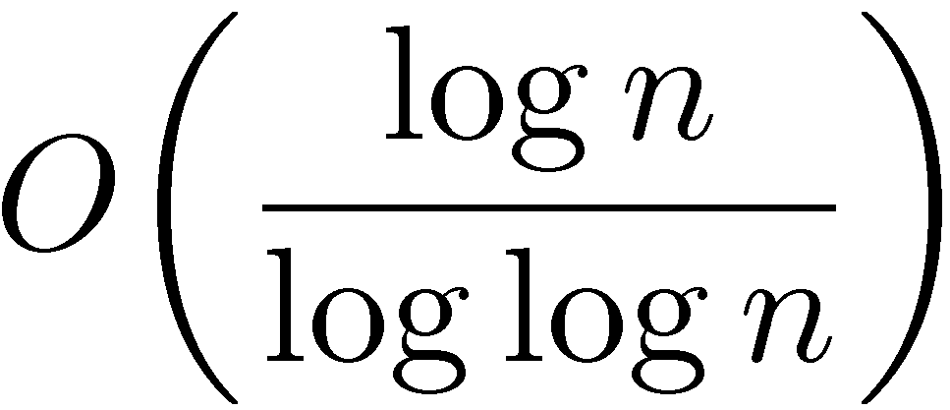
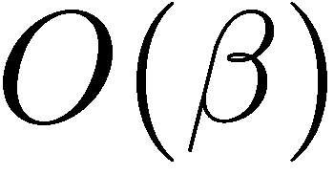
2. Question
Can we be faster on restricted inputs?
Theorem:
SortedPropSampling (where p₁ ¸…¸ p_{n}) can be sampled with
O(log n) preprocessing
O(1) expected query time
or:
preprocessing and
expected query time
preprocessing
Theorem:
Tradeoff:
expected query time
This is tight!

Slide 13
Algo for SortedPropSampling
Given p₁ ¸ … ¸ p_{n}
Blocks B_{k} = { i | 2^{k} · i < 2^{k+1} }
round up p_{i} to q_{i} in each block:
q_{i} := p₂k for i 2 B_{k}
p₁
p₄
p₇
p₁₅
PropSampling:
O(n) preprocessing
O(1) query time
SortedPropSampling:
O(log n) preprocessing
O(1) exp. query time

Slide 14
Algo for SortedPropSampling
Given p₁ ¸ … ¸ p_{n}
Blocks B_{k} = { i | 2^{k} · i < 2^{k+1} }
round up p_{i} to q_{i} in each block:
q_{i} := p₂k for i 2 B_{k}
p₁
p₄
p₇
p₁₅
PropSampling:
O(n) preprocessing
O(1) query time
SortedPropSampling:
O(log n) preprocessing
O(1) exp. query time

Slide 15
Algo for SortedPropSampling
Given p₁ ¸ … ¸ p_{n}
q₁
Blocks B_{k} = { i | 2^{k} · i < 2^{k+1} }
q₄
q₇
round up p_{i} to q_{i} in each block:
q_{i} := p₂k for i 2 B_{k}
q₁₅
p₁
p₄
p₇
p₁₅
PropSampling:
O(n) preprocessing
O(1) query time
SortedPropSampling:
O(log n) preprocessing
O(1) exp. query time

Slide 16
Algo for SortedPropSampling
Given p₁ ¸ … ¸ p_{n}
q₁
Blocks B_{k} = { i | 2^{k} · i < 2^{k+1} }
q₄
q₇
round up p_{i} to q_{i} in each block:
q_{i} := p₂k for i 2 B_{k}
q₁₅
p₁
p₄
p₇
p₁₅
sampling w.r.t. q:
PropSampling:
1. sample block B_{k} with prob. ~ 2^{k} q₂k
2. sample i 2 B_{k} uniformly
O(n) preprocessing
O(1) query time
SortedPropSampling:
O(log n) preprocessing
O(1) exp. query time

Slide 17
Algo for SortedPropSampling
Given p₁ ¸ … ¸ p_{n}
q₁
Blocks B_{k} = { i | 2^{k} · i < 2^{k+1} }
q₄
q₇
round up p_{i} to q_{i} in each block:
q_{i} := p₂k for i 2 B_{k}
q₁₅
p₁
p₄
p₇
p₁₅
sampling w.r.t. q:
PropSampling:
1. sample block B_{k} with prob. ~ 2^{k} q₂k
2. sample i 2 B_{k} uniformly
O(n) preprocessing
O(1) query time
sampling w.r.t. p:
SortedPropSampling:
3. with probability p_{i}/q_{i}: return i
4. otherwise throw away i, goto 1
O(log n) preprocessing
O(1) exp. query time

Slide 18
Algo for SortedPropSampling
Given p₁ ¸ … ¸ p_{n}
q₁
Blocks B_{k} = { i | 2^{k} · i < 2^{k+1} }
q₄
q₇
round up p_{i} to q_{i} in each block:
q_{i} := p₂k for i 2 B_{k}
q₁₅
p₁
p₄
p₇
p₁₅
sampling w.r.t. q:
PropSampling:
1. sample block B_{k} with prob. ~ 2^{k} q₂k
2. sample i 2 B_{k} uniformly
O(n) preprocessing
O(1) query time
sampling w.r.t. p:
SortedPropSampling:
3. with probability p_{i}/q_{i}: return i
4. otherwise throw away i, goto 1
O(log n) preprocessing
O(1) exp. query time
- Pr[returning i] ~ q_{i} ¢ p_{i}/q_{i}
- O(log n) blocks, so use PropSampling for step 1.
- in each iteration: Pr[leaving loop] = Ω(1)

Slide 19
Algo for SortedPropSampling
Given p₁ ¸ … ¸ p_{n}
q₁
Blocks B_{k} = { i | ¯^{k} · i < ¯^{k+1} }
q₄
q₇
round up p_{i} to q_{i} in each block:
q_{i} := p¯k for i 2 B_{k}
q₁₅
p₁
p₄
p₇
p₁₅
sampling w.r.t. q:
PropSampling:
1. sample block B_{k} with prob. ~ ¯^{k} q¯k
2. sample i 2 B_{k} uniformly
O(n) preprocessing
O(1) query time
sampling w.r.t. p:
SortedPropSampling:
3. with probability p_{i}/q_{i}: return i
4. otherwise throw away i, goto 1
O(log¯n) preprocessing
O(¯) exp. query time
- Pr[returning i] ~ q_{i} ¢ p_{i}/q_{i}
- O(log n) blocks, so use PropSampling for step 1.
- in each iteration: Pr[leaving loop] = Ω(1/¯)

Slide 20
2. Question
Can we be faster on restricted inputs?
Theorem:
SortedPropSampling (where p₁ ¸…¸ p_{n}) can be sampled with
O(log n) preprocessing
O(1) expected query time
or:
preprocessing and
expected query time
preprocessing
Theorem:
Tradeoff:
expected query time
This is tight!

Slide 21
3. Question
Can we solve a more general problem?
ab hier: 4:30

Slide 22
3. Question
Can we solve a more general problem?
SubsetSampling:
universe:
{ 1, 2, 3, 4, …, n }
Given p₁,…,p_{n} 2 [0,1].
Sample S µ {1,..,n}
with
independently for all i.
(sorted)
probabilities:
0.7 0.5 0.3 0.2 … 0.1
random
choice:
…
sampled
subset S:
{ 1, 4, …, n }
- random graph generation:
- want to sample the neighbors of a vertex
- set of neighbors is a subset of all vertices

Slide 23
3. Question
Can we solve a more general problem?
SubsetSampling:
universe:
{ 1, 2, 3, 4, …, n }
Given p₁,…,p_{n} 2 [0,1].
Sample S µ {1,..,n}
with
independently for all i.
(sorted)
probabilities:
0.7 0.5 0.3 0.2 … 0.1
random
choice:
…
sampled
subset S:
{ 1, 4, …, n }
Reduction: PropSampling · SubsetSampling

Slide 24
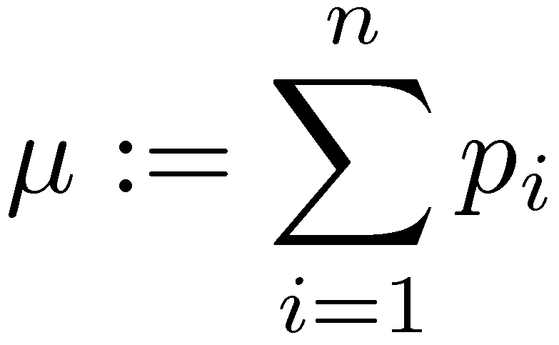
3. Question
Can we solve a more general problem?
SubsetSampling:
universe:
{ 1, 2, 3, 4, …, n }
Given p₁,…,p_{n} 2 [0,1].
Sample S µ {1,..,n}
with
independently for all i.
(sorted)
probabilities:
0.7 0.5 0.3 0.2 … 0.1
random
choice:
…
sampled
subset S:
{ 1, 4, …, n }
-
- optimal expected query time: O(1+¹)

Slide 25
3. Question
Can we solve a more general problem?
SubsetSampling:
universe:
{ 1, 2, 3, 4, …, n }
Given p₁,…,p_{n} 2 [0,1].
Sample S µ {1,..,n}
with
independently for all i.
(sorted)
probabilities:
0.7 0.5 0.3 0.2 … 0.1
random
choice:
…
sampled
subset S:
{ 1, 4, …, n }
Theorem:
Theorem:
SubsetSampling:
SortedSubsetSampling:
O(n) preprocessing
O(1+¹) expected query time
O(log n) preprocessing
O(1+¹) expected query time

Slide 26
Overview of Results
Theorem:
Theorem:
SubsetSampling:
SortedSubsetSampling:
O(n) preprocessing
O(1+¹) expected query time
O(log n) preprocessing
O(1+¹) expected query time
Reduction
Reduction
[Walker’77]:
Theorem:
PropSampling:
SortedPropSampling:
O(n) preprocessing
O(1) query time
O(log n) preprocessing
O(1) expected query time

Slide 27
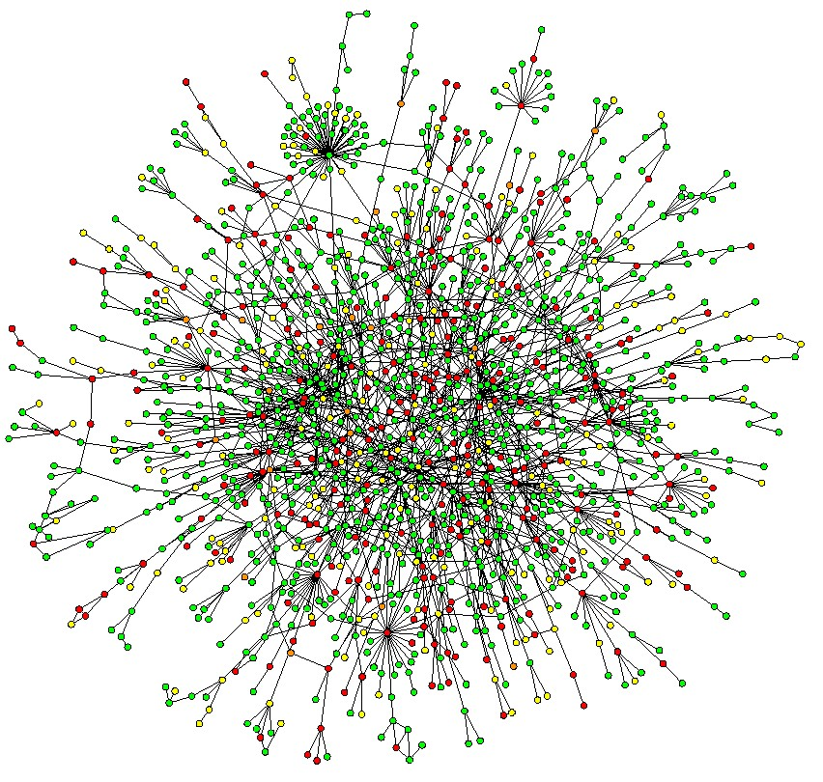
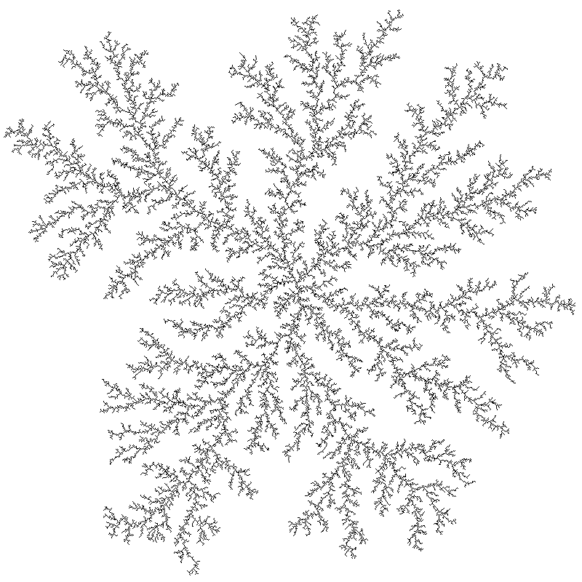
Future Work
- apply these methods to:
- random graph generation
[www.math.cornell.edu/~durrett/RGD/RGD.html]
- faster simulation of physical models
- more general inputs:
what classes to look at?
- prove remaining lower bounds
- explore dynamic setting
Thank you for your attention!
[http://people.sc.fsu.edu/~jburkardt/data/gif/dla.gif]

Slide 28
Overview of Results
Theorem:
Theorem:
SubsetSampling:
SortedSubsetSampling:
O(n) preprocessing
O(1+¹) expected query time
O(log n) preprocessing
O(1+¹) expected query time
Reduction
Reduction
[Walker’77]:
Theorem:
PropSampling:
SortedPropSampling:
O(n) preprocessing
O(1) query time
O(log n) preprocessing
O(1) expected query time

Slide 29
Reduction from Prop to Subset
1. step: reduce PropSampling to ¹ = §_{i} p_{i} = £(1)

Slide 30
Reduction from Prop to Subset
1. step: reduce PropSampling to ¹ = §_{i} p_{i} = £(1)
Given p₁ ¸ … ¸ p_{n}
q₁
Blocks B_{k} = { i | 2^{k} · i < 2^{k+1} }
q₄
q₇
round up p_{i} to q_{i} in each block:
q_{i} := p₂k for i 2 B_{k}
q₁₅
p₁
p₄
p₇
p₁₅

Slide 31
Reduction from Prop to Subset
1. step: reduce PropSampling to ¹ = §_{i} p_{i} = £(1)
Given p₁ ¸ … ¸ p_{n}
q₁
Blocks B_{k} = { i | 2^{k} · i < 2^{k+1} }
q₄
q₇
round up p_{i} to q_{i} in each block:
q_{i} := p₂k for i 2 B_{k}
q₁₅
p₁
p₄
p₇
p₁₅
- §_{i} q_{i} can be computed in time O(log n)
new instance:
- ¹ · §_{i} q_{i} · 2 ¹
p’:
- compute new instance lazily
¹’: ½ · ¹’ · 1

Slide 32
Reduction from Prop to Subset
2. step: reduction to SubsetSampling for ¹ = §_{i} p_{i} = £(1)
(Sorted)PropSampling
(Sorted)SubsetSampling
Given p=(p₁,…,p_{n})
p
repeat
X = SubsetSampling(q)
until |X| = 1
X
return X
(or the element of X)

Slide 33
Reduction from Prop to Subset
2. step: reduction to SubsetSampling for ¹ = §_{i} p_{i} = £(1)
(Sorted)PropSampling
(Sorted)SubsetSampling
Given p=(p₁,…,p_{n})
p
repeat
X = SubsetSampling(q)
until |X| = 1
X
return X
(or the element of X)
- X|_{|X|=1} ~ PropSampling(p)
- Pr[ |X| = 1 ] = Ω(1)
- query time O(1+¹) = O(1)

Slide 34
Overview of Results
Theorem:
Theorem:
SubsetSampling:
SortedSubsetSampling:
O(n) preprocessing
O(1+¹) expected query time
O(log n) preprocessing
O(1+¹) expected query time
Reduction
Reduction
[Walker’77]:
Theorem:
PropSampling:
SortedPropSampling:
O(n) preprocessing
O(1) query time
O(log n) preprocessing
O(1) expected query time

