Slide 1
The Online Labeling Problem
Jan Bulánek
(Institute of Math, Prague)
Martin Babka (Charles University)
Vladimír Čunát (Charles University)
Michal Koucký (Institute of Math, Prague)
Michael Saks (Rutgers University)

Slide 2
Sorted Arrays
Basis of many algorithms
Easy to work with
Dynamization?
Online Labeling

Slide 3
Storing elements in the array
1
-5
32
7
14
12
Gaps in the array
Muze pohnout co chce
…
Stream of n elements
3 |  |  |  |  |  |  |  | 19
7
12
11
15
Array of size Θ(n)

Slide 4
Online labeling
Input
A stream of n numbers
An array of size m
For the size Θ(n) File maintenance problem
Goal
maintain a sorted array of all already seen items
minimize the total number of item moves (cost)
Rict ze diry mi sami o sobe nestaci
Naïve solution O(n) per insertion

Slide 5
Applications
Many applications, e.g.:
[Bender, Demaine, Farach-Colton ’00]
Cache-oblivous B-trees
[Emek, Korman ’11]
Distributed Controllers
Lower bounds

Slide 6
Algorithm for linear arrays
[Itai, Konheim, Rodeh ’81]
O(log² n) per insertion, amortized
[Itai, Katriel ’07]
Simpler algorithm
Basic ideas
Small gaps
Spread items evenly
Density threshold function

Slide 7
Algorithm for linear arrays – cont.
How to find segment to rearrange
Too dense
Rearrange items evenly
Good density

Slide 8
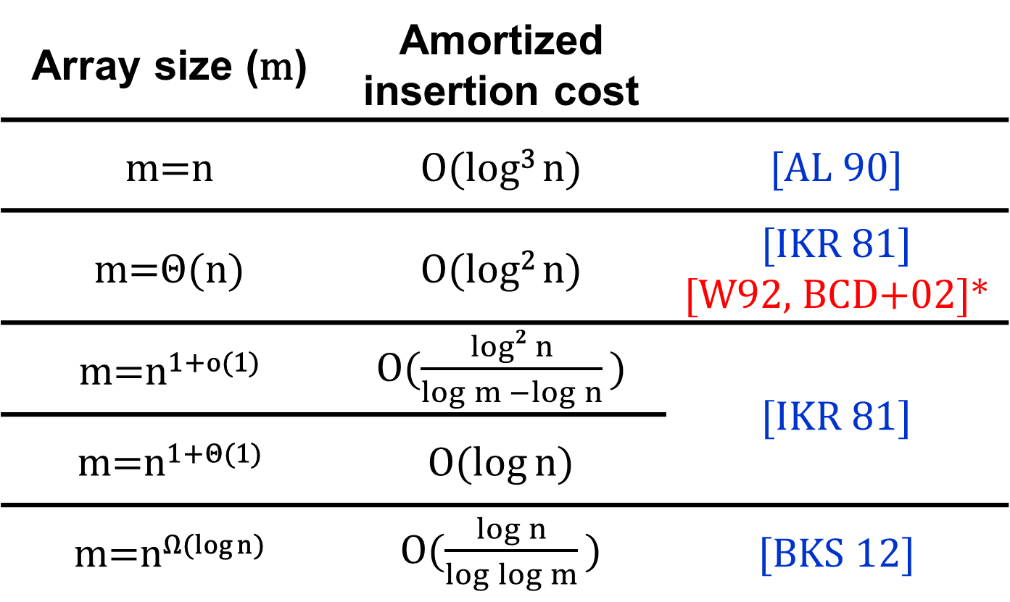
Upper bounds
Array size (m) | Amortized insertion cost
m=n | O(log³ n) | [AL 90]
m=Θ(n) | O(log² n) | [IKR 81] [W92, BCD+02]*
m=n^{1+o(1)} | O($\frac{log2{n}}{\log{m −\log{n}}}$ ) | [IKR 81]
m=n^{1+Θ(1)} | O(log n)
m=n^{Ω(log n)} | O($\frac{\log{n}}{\log{\log{m}}}$ ) | [BKS 12]
TIGHT!!
Andersson lai

Slide 9
Lower Bounds
[Zhang ’93]
m=O(n)
Ω(log² n) per insertion, amortized
Only smooth strategies
[Dietz, Seiferas, Zhang ’94]
m=n^{1+Θ(1)}
Ω(log n) per insertion, amortized
Proof contains a gap

Slide 10
Lower Bounds – cont.
[B., Koucký, Saks STOC’12]
All strategies
Even for limited universe
.
m=n | Ω(log³ n)
m=Θ(n) | Ω(log² n)

Slide 11
Lower Bounds – cont.
[Babka, B., Čunát, Koucký, Saks ESA’12]
All strategies
Fills the gap in [DSZ ’04] and extends their result
Tight bounds for the bucketing game
m=n^{1+Θ(1)} | Ω($\log{n}$)
m=n^{1+Ω (1)} | Ω($\frac{\log{n}}{\log{\log{m}−log log n}}$ )

Slide 12
Lower Bounds – cont.
[Babka, B., Čunát, Koucký, Saks 12, manuscript]
All strategies
Extends results of [BKS 12]
m=n^{1+o(1)} | Ω($\frac{log2{n}}{\log{m −\log{n}}}$ )

Slide 13
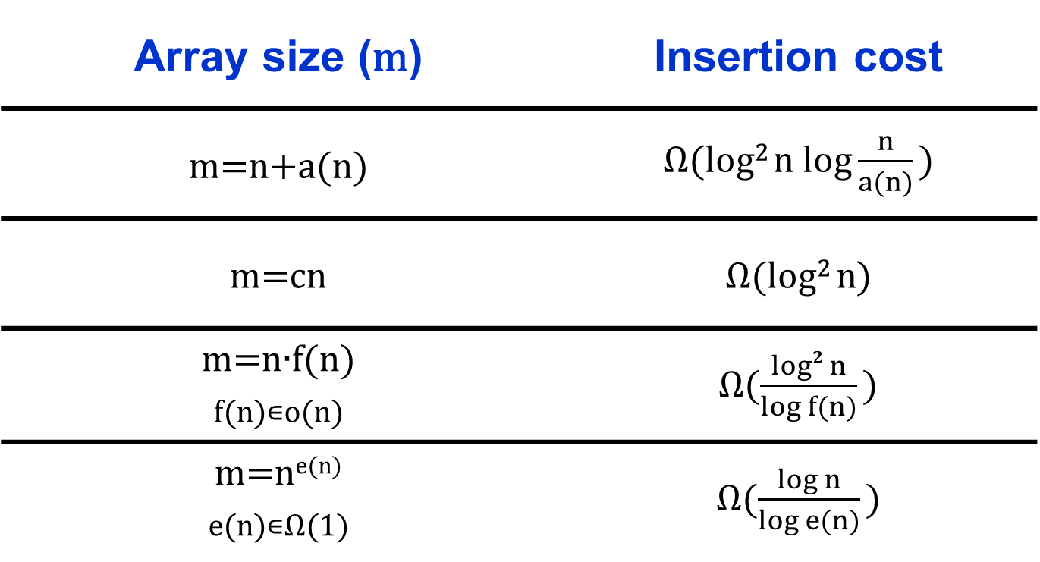
Lower Bounds – Sumary
Array size (m) | Insertion cost
m=n+a(n) | Ω(log² n$log\frac{n}{a(n)}$ )
m=cn | Ω($\text{log}\text{2 }\text{n}$)
m=n∙f(n) f(n)∊o(n) | Ω($\frac{log2{n}}{\log{f(n)}}$ )
m=n^{e(n)} e(n)∊Ω(1) | Ω($\frac{\log{n}}{\log{e(n)}}$ )

Slide 14
Limited universe
U
m
n

Slide 15
Open problems
Randomized algorithms?
Limited universe m log n
The End!

Slide 16
1
-5
32
7
14
…
3 |  | 7 |  |  | 12 | 15 |  | 19

Slide 17
1
-5
32
7
…
3 | 7 |  |  | 12 | 14 |  | 15 | 19

Slide 18
1
-5
32
7
…
14
3 |  | 7 |  |  | 12 | 15 |  | 19

Slide 19
Algorithm for linear arrays – cont.
How to find segment to rearrange
Too dense
Rearrange items
Good density

Slide 20
Algorithm for linear arrays – cont.
How to find segment to rearrange
Too dense
Rearrange items
Good density

Slide 21
Algorithm for linear arrays – cont.
How to find segment to rearrange
Too dense
Good density

Slide 22
Algorithm for linear arrays – cont.
How to find segment to rearrange
Too dense

Slide 23
Algorithm for linear arrays – cont.
How to find segment to rearrange
Too dense
Good density

Slide 24
Upper bounds
Array size (m) | Amortized insertion cost
m=n | O(log³ n) | [AL 90]
m=Θ(n) | O(log² n) | [IKR 81] [W92, BCD+02]*
m=n^{1+o(1)} | O($\frac{log2{n}}{\log{m −\log{n}}}$ ) | [IKR 81]
m=n^{1+Θ(1)} | O(log n)
m=n^{Ω(log n)} | O($\frac{\log{n}}{\log{\log{m}}}$ ) | [BKS 12]
Andersson lai
TIGHT!!

