Slide 1
Space-bounded Communication Complexity
Hao Song
Institute for Theoretical Computer Science
Institute for Interdisciplinary Information Sciences
Tsinghua University
China Theory Week 2012, at Aarhus University
joint work with:
Joshua Brody, Shiteng Chen, Periklis Papakonstantinou, Xiaoming Sun

Slide 2
Lower Bounds and Information
model: can test x>y
x,y input elements
input: x1, x2,... ,xn
output: the input sequence sorted
Theorem: for every A in this model
there exists input I
s.t. A(I) runs for ≈ n*log(n) steps
In computer science research, most (unconditional) lower bounds have an information theoretic nature, but for a few exceptions:
(time/space hierarchy etc.)
how to construct this input I?
...you don’t!
uniformity and lower bounds...
x4 > x6
fix the input length n
YES
NO
fix an arbitrary algorithm An
x1 > x3
x42 > x21
there are n!≈2^{n*log(n)}
many leaves
we need n*log(n) bits to
distinguish between the leaves

Slide 3
Communication Complexity
Alice and Bob collaborate to compute f: {0,1}^{n} x {0,1}^{n} -> {0,1}
f(x,y) = ?
x
y
A
B
we measure: number of bits communicated
[Yao 1979]
why information theoretic? because the players are computationally unbounded
the only difficulty in determining f(x,y) is lack of information

Slide 4
An Application to Streaming
It’s conjectured that
REACH is not even in L!
#passes we want to prove is ∞!
just for a moment forget everything we said about communication complexity
REACH(G, s, t) = 1 iff t is reachable from s in G
Theorem: every protocol for REACH has CC ≥ n
?
Application: unconditional streaming lower bounds
can we compute REACH with
r(n) = n^{1/2} passes ?
How to go above
n/log(n)?
input steam
log n
working memory
x1 , x2 , ..., xn , y1 , y2 , ..., yn
Player B
waiting...
this protocol = r(n)logn bits
every protocol ≥ n
=> #passes ≥ n/logn
Player A
Simulate M until the head crosses to the y part of the tape
Player B
Simulate M until the head crosses to the x part of the tape again
how a communication lower bound
may help us proving a streaming
bound?
M’s config.
M’s config.

Slide 5
Outline
our basic model
variant – the one-way semi-oblivious model
example problems – Inner Product, 2-bit EQ, etc.
on going work...

Slide 6
The Basic Model

Slide 7
Communication Complexity with Space Bound
Alice and Bob collaborate to compute f: {0,1}^{n} x {0,1}^{n} -> {0,1}
x
y
A
B
memory
memory
everything the players can remember from their
interaction is stored in their local memory space
still a purely information theoretic model
x
first: receive a bit from B
A
second: given the
(i) received bit,
(ii) the current memory and
(iii) x
memory
1. update the memory
2. determine which bit to send to B
memory

Slide 8
Previous Works
Straight-Line Protocols
(or Communicating Circuits)
Communicating
Branching Programs
Lam, Tiwari & Tompa 1989
Beame, Tompa & Yan 1990
space-communication tradeoffs:
matrix-matrix multiplication, matrix-vector multiplication, etc
adopting existing techniques into communication setting
does including a computation model help to prove stronger lower
bounds?
generally speaking: not really with current techniques
so we simply don’t do it
go the opposite direction
our model: communicating state machines

Slide 9
Motivation
take your favorite argument in communication complexity...
... chances are that by restricting players’ memory:
i. the same argument goes through
ii. super-linear lower bounds make your dream come true
examples: realistic streaming lower bounds,
NC circuit lower bounds...
an exciting possibility:
difficult open problems in Communication Complexity
e.g. direct-sum theorems
may find partial answers
makes the discussion on memory types possible

Slide 10
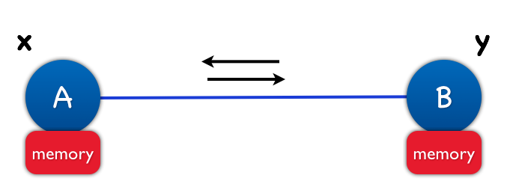
Bad News
The space-bounded communication model is at least as powerful as the space bounded Turing Machine model
take L in SPACE(s(n)) & view it as a comm. problem => it can be decided with s(n) space-protocol
there is a boolean function (easy to compute)
not computable by Ω(log(n))-space protocol
-> LogSPACE ≠ P
these are bad news for the general model
we only have super-linear lower bounds for non-boolean functions
[Lam – Tiwari – Tompa 1989] [Beame – Tompa – Yan 1990]
our own incomputability results

Slide 11
One-Way Semi-Oblivious

Slide 12
One-Way Model
blah, blah, blah
x
y
blah, blah
A
blah, blah, blah, blah...
B
?
memory
memory
is it necessary to put limit on Alice’s memory?
Yes
restrict both Alice’s and Bob’s memory ...
otherwise the model becomes all-powerful
Fact:
L is TM computable in space k·log(n)
=>
L as comm. problem computable by (k+1)log(n) - space protocol
these are bad news for the one-way model

Slide 13
Motivating Examples for the Oblivious Memory
EQ - EQuality
x = 110
y = 111
1
1
0
A
B
1
2
3
2
1
3
EQ(110, 111)=0
IP – Inner Product over GF(2)
x = 110
y = 111
0
1
1
A
B
2
2
1
3
0
1
1
3
IP(110, 111)=0

Slide 14
Oblivious Updates
x
y
A
B
memory
memory
memory
memory
update the memory obliviously = independent to y
defn: this one-way model is called oblivious
...or we may update the memory in part obliviously and in part non-obliviously
memory
defn: this one-way model is called semi-oblivious

Slide 15
Memory Hierarchy Theorems
the weaker (and unsurprising) one
almost every function f: {0,1}^{n} x {0,1}^{n} -> {0,1} requires space (1-ε)n to be computed in the general model
the stronger (and somewhat surprising) one
almost every function f: {0,1}^{n} x {0,1}^{n} -> {0,1} that can be computed with s(n)+log(n) oblivious bits cannot be computed with s(n) non-oblivious bits
The oblivious memory is not as weak as one might originally think.
corollary
Memory hierarchy theorems for the general model and the one-way oblivious model

Slide 16
Example Problems
Inner Product, 2-bit EQ, etc.

Slide 17
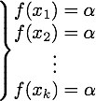
The IP Lower Bound
Theorem: there is no protocol with s(n)<n/8 oblivious bits of memory
(and zero non-oblivious ones) which computes Inner Product over GF(2)
proof idea:
Protocol Matrix
Bob
y1
y2
y3
y₂n
Alice
x1
x2
a “band”
x3
fix step #7 of the protocol
each entry is one of the three:
i. 0
ii. 1
iii. H (for Halt)
we can think of Alice as uploading Bob’s memory content based on her input x
...
x₂n

Slide 18
The IP Lower Bound
“partially halted” column: a column with at least one “H”
progress measure: the number of “partially halted” columns
proof idea:
Protocol Matrix
Bob
y1
y2
y3
y₂n
Alice
1
1
1
1
1
H
1
H
1
1
1
1
0
0
0
0
1
1
1
1
x1
x2
x3
...
x₂n

Slide 19
The IP Lower Bound
“narrow” bands: can be ignored, deleted from the matrix
“wide” bands: limited contribution to progress
--- size upper bound of monochromatic rectangles
proof idea:
Protocol Matrix
Bob
y1
y2
y3
y₂n
Alice
1
1
1
1
1
1
1
1
0
0
0
0
1
1
1
1
x1
x2
x3
...
x₂n

Slide 20
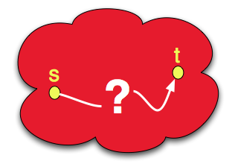
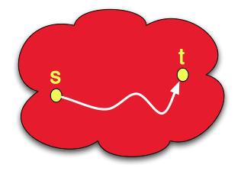
EQ, IP and STCONN
here are three of the most fundamental functions ...
equality
inner product
st-connectivity
EQ(x,y)=1 iff x=y
IP(x,y) = x1y1+...+xnyn
REACH(G,s,t) = 1
use the semi-oblivious model as a vehicle that provides
explanations & new techniques on the use of space when computing
EQ, IP, and REACH
... can we say anything non-trivial
(without resolving long-standing open questions)
regarding their space complexity?
Facts & Conjectures:
x1 , x2 , ..., xn , y1 , y2 , ..., yn
=
=
...
=

Slide 21
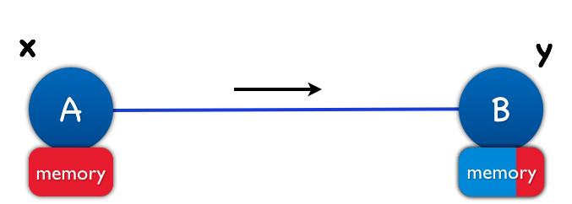
EQ, IP and STCONN
equality
inner product
st-connectivity
EQ(x,y)=1 iff x=y
IP(x,y) = <x,y>
REACH(G|A,G|B) = 1 iff node n is reachable
from node 1
can be done:
can be done:
can be done: let’s talk about it…
IP reduces to REACH
non-oblivious bits: 0
non-oblivious bits: 1
oblivious bits: log(n)
oblivious bits: log(n)
?
can NOT be done
can NOT be done
non-oblivious bits: 0
non-oblivious bits: 1

Slide 22
2-bit EQ
Problem definition
Input: Alice has n-bit strings (x₁, x₂), Bob has n-bit strings (y₁, y₂)
Output: 2-bit, x₁=y₁? x₂=y₂?
How to solve it with one-way oblivious protocol?
thinking about execute the straightforward EQ protocol twice?
but unfortunately, that won’t work
when will Bob start to compute the 2nd output bit?
storing the 1st output bit in Bob’s memory? no longer oblivious
actually, there is a one-way oblivious protocol for every function, with space cost n
the hard part is – do it with small space cost, ideally, polylog(n)

Slide 23
2-bit EQ – Parallel Repetition
boolean function f₁(x, y) with one-way oblivious protocol P₁, communication cost C₁, space cost S₁
boolean function f₂(x, y) with one-way oblivious protocol P₂, communication cost C₂, space cost S₂
compute 2-bit f(x, y)={f₁(x, y), f₂(x, y)} by simulating P_{1,} P₂
simulate the 1st step of P₁
simulate P₂ for C₂+1 steps
simulate the 2nd step of P₁
simulate P₂ for C₂+1 steps
… …
until at some step, Bob knows both f₁(x, y) and f₂(x, y)

Slide 24
What’s Left
to Be Done?

Slide 25
Almost Everything is Open
further directions...
investigate the relationship to circuit complexity
prove a lower bound for REACH for 2 (or more) non-oblivious bit
the model in the presence of randomness
applications of the semi-oblivious model to other areas ?
better memory hierarchy theorems

Slide 26
Thank you!

