Slide 1
A Fairy Tale of Greedy Algorithms
Yuli Ye
Joint work with Allan Borodin, University of Toronto

Slide 2
Why do we study greedy algorithms?
don’t
A quote from Jeff Erickson’s algorithms book
Everyone should tattoo the following sentence on the back of their hands, right under all the rules about logarithms and big-Oh notation:

Slide 3
Why do we study greedy algorithms?
Greedy algorithms are
simple: easy to state and implement
natural: intuitive to come up with an algorithm
efficient: often has a low-degree polynomial running time
flexible: different greedy algorithms for a single problem
Greedy algorithms are widely used in practice as heuristics, and sometimes have good performance.
The analysis of greedy algorithms can be non-trivial; their power and limitations are not well-understood.

Slide 4
What is a greedy algorithm?
“I know it when I see it!”

Slide 5
What is a greedy algorithm?
A greedy algorithm is an iterative procedure that at each step makes decisions on the input items. These decisions are usually:
local: decisions only use local information about the input (hence computationally efficient);
Input

Slide 6
What is a greedy algorithm?
A greedy algorithm is an iterative procedure that at each step makes decisions on the input items. These decisions are usually:
local: decisions only use local information about the input (hence computationally efficient);
irrevocable: once determined, decisions cannot be changed afterwards;
greedy: decisions are made on items optimizing with respect to a certain criterion.

Slide 7
An example of a greedy algorithm
Min Vertex Cover (VC):
A greedy algorithm for VC:
At each step, add to the cover a vertex that covers the most uncovered edges (largest degree heuristic).
This algorithm is an Hn-approximation for VC.

Slide 8
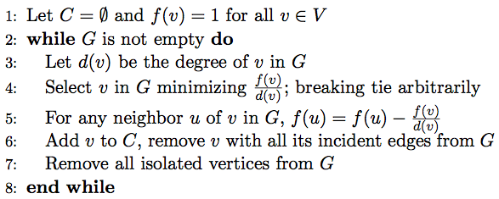
An example of a greedy algorithm
Clarkson’s Algorithm for VC:
Without line 5, this is exactly the previous algorithm. The Clarkson’s Algorithm is a 2-approximation for VC.

Slide 9
What is a greedy algorithm?
A greedy algorithm is an iterative procedure that at each step makes decisions on the input items. These decisions are usually:
local: decisions only use local information about the input (hence computationally efficient);
irrevocable: once determined, the decision cannot be changed afterwards;
greedy: decisions are made on items optimizing with respect to a certain criterion. (what criterion to use?)

Slide 10
A main question for the talk
How to decide an ordering of input items which should be considered by a greedy algorithm?
Orderings by direct properties of input items
Orderings constructed using structural properties of the input
Orderings guided by (non-obvious) potential functions

Slide 11
Direct properties
Depending on the type of problems and the encoding of an input item; (can be lengths, degrees, weights, sizes, …)
Ex: Subset Sum (SS)
If you can only look at one integer at a time and make an irrevocable decision on it, what is the best ordering you would like to see them?

Slide 12
Direct properties
A natural guess would be see them in a decreasing order of value, or even better, see the largest integer first, make a decision on it, and then decide what to see next.
priority
A greedy algorithm using this ordering depicted in the red line gives a 0.657-approxiamtion for SS. [YB07]
This is in fact the best ordering under reasonable assumptions. [YB07]
0
0.34c
0.43c
0.66c
c
value

Slide 13
Structural properties
Structural properties are particularly interesting for graph problems.
Ex: Max Independent Set (MIS) for Chordal Graphs
If you can only look at one vertex at a time and make an irrevocable decision on it, what is the best ordering you would like to see them?

Slide 14
Structural properties
A natural guess might be see them in a increasing order of degree. However chordal graphs have a useful structural property:
We can always find a vertex whose neighbours form a clique, and after removing it, the graph is still chordal.
This yields what is known as the perfect elimination ordering (PEO). It can be constructed in linear time. [FG65]
A greedy algorithm using this ordering is optimal for MIS on chordal graphs.

Slide 15
Structural properties
We can extend PEOs in the following way:
An ordering of vertices is inductive k-independent if for any vertex, the graph induced by its neighbours appearing later in the ordering has an MIS <= k.
Families of inductive k-independence graphs (with a small fixed k) is rich; (e.g., planar graphs and unit disk graphs are inductive 3-independent.) [YB09] – maybe sketch a short proof
Given such ordering (if there is one), greedy algorithms can achieve relatively good approximation ratios for problems like MIS, Colouring, VC. [YB09]

Slide 16
Potential functions
Ex: Single-Minded Combinatorial Auction
If you can only look at one set at a time and make an irrevocable decision on it, what is the best ordering you would like to see them?
$53
$42
$32
$28
$37
$48

Slide 17
Potential functions
Let v be the value of a set S, we select the next set maximizing the following potential function:
This is the α-Greedy Algorithm of Lehmann, O’Callaghan and Shoham, which achieves the best approximation ratio for this problem. [LOS02]
Ex: Max-Sum Diversification
In many practical settings, we would like to select a subset not only with a good quality but also diversified.

Slide 18
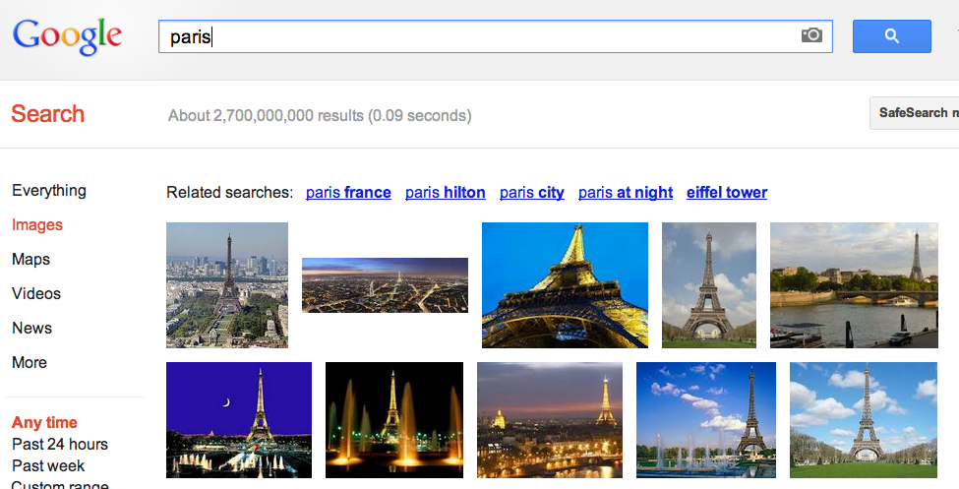
Why need diversity?
Top-k Query in Database:
Given a search query, finding the top k results relating to the query.
paris

Slide 19
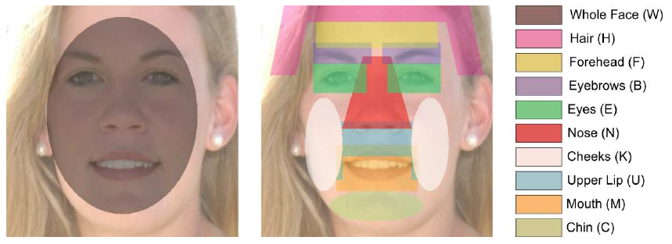
Why need diversity?
Feature Selection in Machine Learning:
Selecting a subset of relevant features for building robust learning models.
A common hypothesis in the correlation feature selection: Good feature subsets contain features highly correlated with the classification, yet uncorrelated to each other.

Slide 20
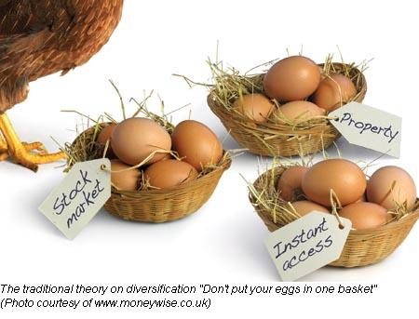
Why need diversity?
Portfolio management in Finance:
Allocating equities and hoping for a good annual return.

Slide 21
Potential functions
Given a universe of elements in a metric space and a normalized, monotone, submodular function defined on the set of subsets, the goal is to select a subset of a fixed size maximizing the following:
If you can only look at one element at a time and make an irrevocable decision on it, what is the best ordering you would like to see them?
Quality
Diversity

Slide 22
Potential functions
Let S be the current set, let be the marginal gain on the quality by adding u to S, and let be the marginal gain on the diversity by adding u to S. We select the next element maximizing the following potential function:
This greedy algorithm achieves an approximation ratio of 2 for the max-sum diversification problem. [BCY12]

Slide 23
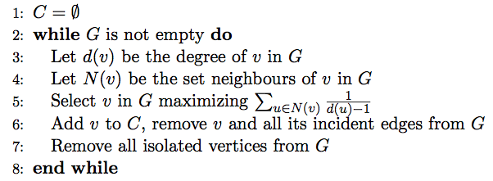
A puzzle
Algorithm No-Name for VC:
This algorithm is not optimal, but I do not know any input instance with ratio greater than or equal to 2 and I do not know how to analyze it.

Slide 24
Conclusions
Greedy algorithms can be quite useful and powerful.
There is a lot of flexibility in designing a greedy algorithm.
We still know very little about greedy algorithms as a algorithmic paradigm. And I hope you want to understand them better after this talk ☺.
THANK YOU!

