Slide 1

Algorithm Design Using Spectral Graph Theory
Richard Peng
Joint Work with Guy Blelloch, HuiHan Chin, Anupam Gupta, Jon Kelner, Yiannis Koutis, Aleksander Mądry, Gary Miller and Kanat Tangwongsan
Notes:
1

Slide 2
Outline
Motivating problem: image denoising
Fast solvers for SDD linear systems
Using solver for L₁ minimization and graph problems.

Slide 3
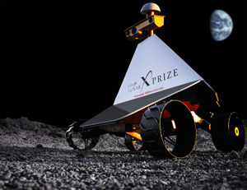
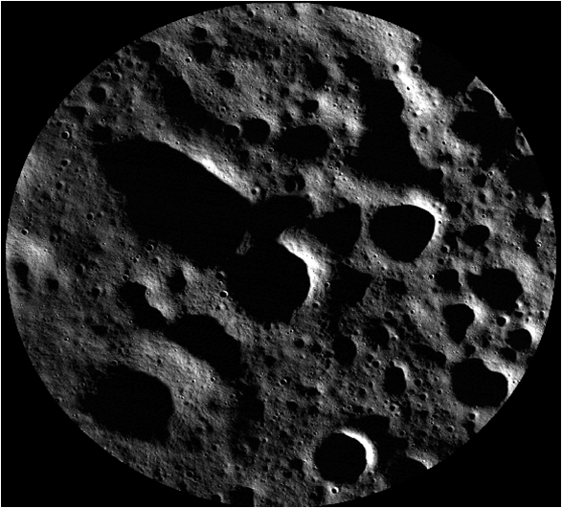
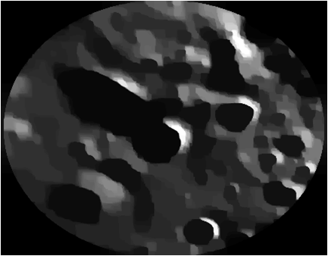
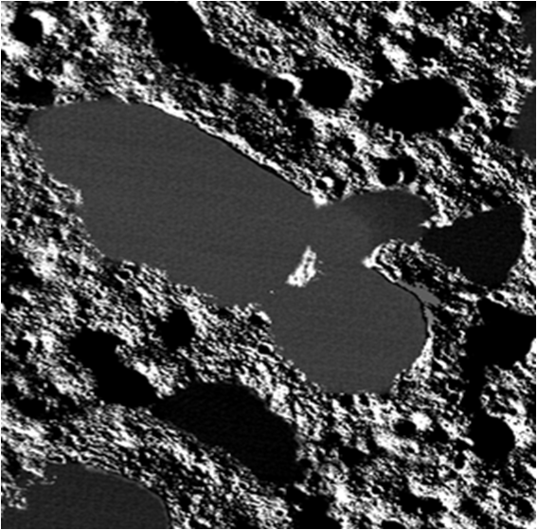
Image Denoising
Given image + noise, recover image.
Notes:
CMU’s space program
Rocket takes picture of moon surface
Noisy picture, want to finding landing site from it.

Slide 4
Image Denoising: the Model
Input:
s
‘original’ noiseless image.
noise from some distribution added.
input: original + noise, s.
goal: recover original, x.
Denoised Image:
x
Noise:
s-x
Notes:
Noise is s-x in this setting

Slide 5
Explicit vs. Implicit Approaches
 | Explicit | Implicit
Goal | Recover x directly | Define conditions on x and s, solve for x
Basic Operation | Averaging a set of pixels Filtering | Minimize objective function
Runtime | O(n) | O(n²) or higher
Quality | Reasonable | High
n > 10⁶ for most images
First give a simplified objective that can be optimized fast

Slide 6
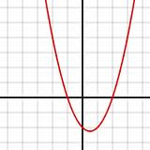
Simple Objective Function
minimizeΣ_{i}(x_{i}-s_{i})² + Σ_{i~j}(x_{i}-x_{j})²
Solution recovered has quality issues, will come back to this later.
Equal to x^{T}Ax-2s^{T}x where x, s are length n vectors, A is n-by-n matrix
Gradient: 2Ax – 2s
Optimal: 0 = 2Ax – 2s
Ax = s
x = A⁻¹s
Notes:
Same as minimizing quadratics in a single variable

Slide 7
Special Structure of A
A is Symmetric Diagonally Dominant (SDD) if:
It’s symmetric
In each row, diagonal entry at least sum of absolute values of all off diagonal entries

Slide 8
Outline
Motivating problem: image denoising
Fast solvers for SDD linear systems
Using solver for L₁ minimization and graph problems.

Slide 9
Fundamental Problem:
Solving Linear Systems
Given matrix A, vector b
Find vector x such that Ax=b
Size of A:
n-by-n
m non-zero entries
Notes:
Formally the running time can be characterized using n and m.

Slide 10
Solving Linear Systems:
Explicit and Implicit
 | Direct (explicit) | Iterative (implicit)
‘Unit’ Operation | Modifying entry | Matrix-vector multiply
Main goal | Operations applied on matrix are reversible | Explored large portion of rank space
Cost per step | O(1) | O(m)
Numer of Steps | O(n^{ω}) | O(n)
Total Runtime | O(n^{ω}) | O(nm)

Slide 11
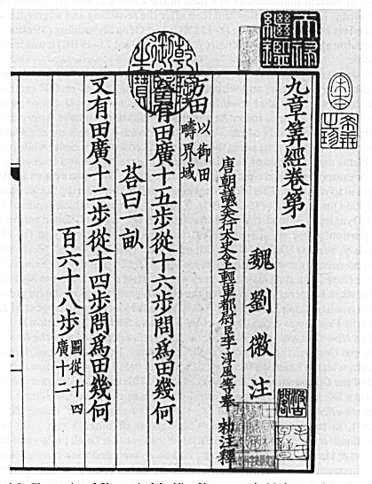
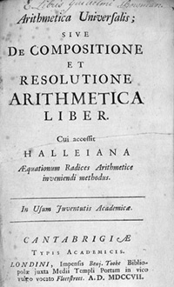
Explicit Algorithms
[1st century CE] Gaussian Elimination: O(n³)
[Strassen `69] O(n^{2.8})
[Coppersmith-Winograd `90] O(n^{2.3755})
[Stothers `10] O(n^{2.3737})
[Vassilevska Williams`11] O(n^{2.3727})
Notes:
Chinese math text, also studied by Newton

Slide 12
SDD Linear Systems
 | Direct (explicit) | Iterative (implicit)
‘Unit’ Operation | Modifying entry | Matrix-vector multiply
Main idea | Operations applied on matrix are reversible | Explored large portion of rank space
Cost per step | O(1) | O(m)
Numer of Steps | O(n^{ω}) | O(n)
Total Runtime | O(n^{ω}) | O(nm)
[Vaidya `91]: Hybrid methods

Slide 13
Nearly Linear Time Solvers
[Spielman-Teng ‘04]
Input: n by n SDD matrix A with m non-zeros
vector b
Where: b = Ax for some x
Output: Approximate solution x’ s.t.
|x-x’|_{A}<ε|x|_{A}
Runtime: Nearly Linear
O(mlog^{c}n log(1/ε)) expected
Notes:
Spielman and Teng showed that SDD linear systems can be solved in nearly-linear time

Slide 14
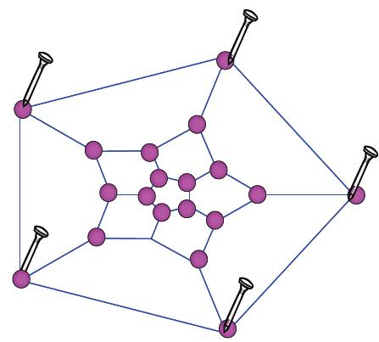
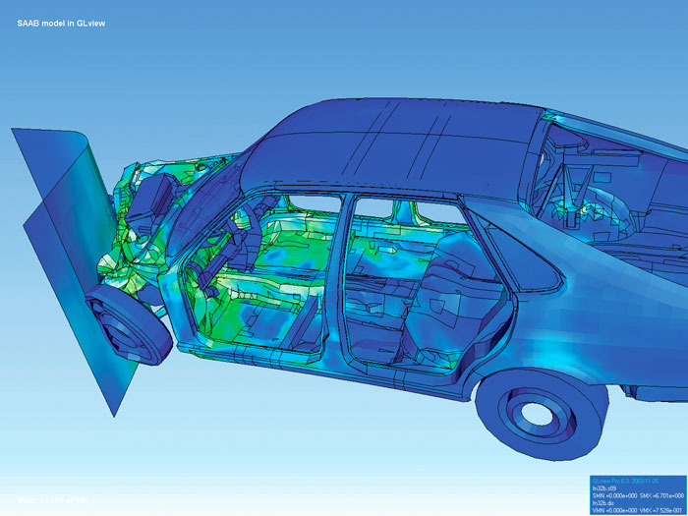
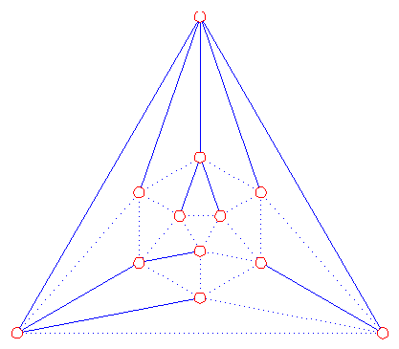
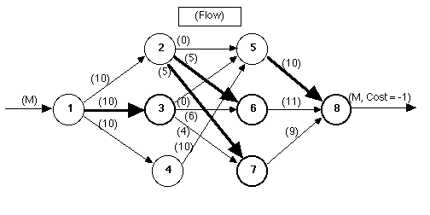
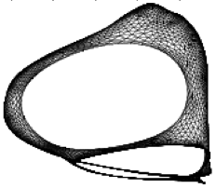

Theoretical Applications of SDD Solvers: Many Iterations
[Zhu-Ghahramani-Lafferty `03][Zhou-Huang-Scholkopf `05] learning on graphical models.
[Tutte `62] Planar graph embeddings.
[Boman-Hendrickson-Vavasis `04] Finite Element PDEs
[Kelner-Mądry `09] Random spanning trees
[Daitsch-Spielman `08] [Christiano-Kelner-Mądry-Spielman-Teng `11] maximum flow, mincost flow
[Cheeger, Alon-Millman `85, Sherman `09, Orecchia-Sachedeva-Vishnoi `11] graph partitioning
Notes:
Many theoretical applications

Slide 15
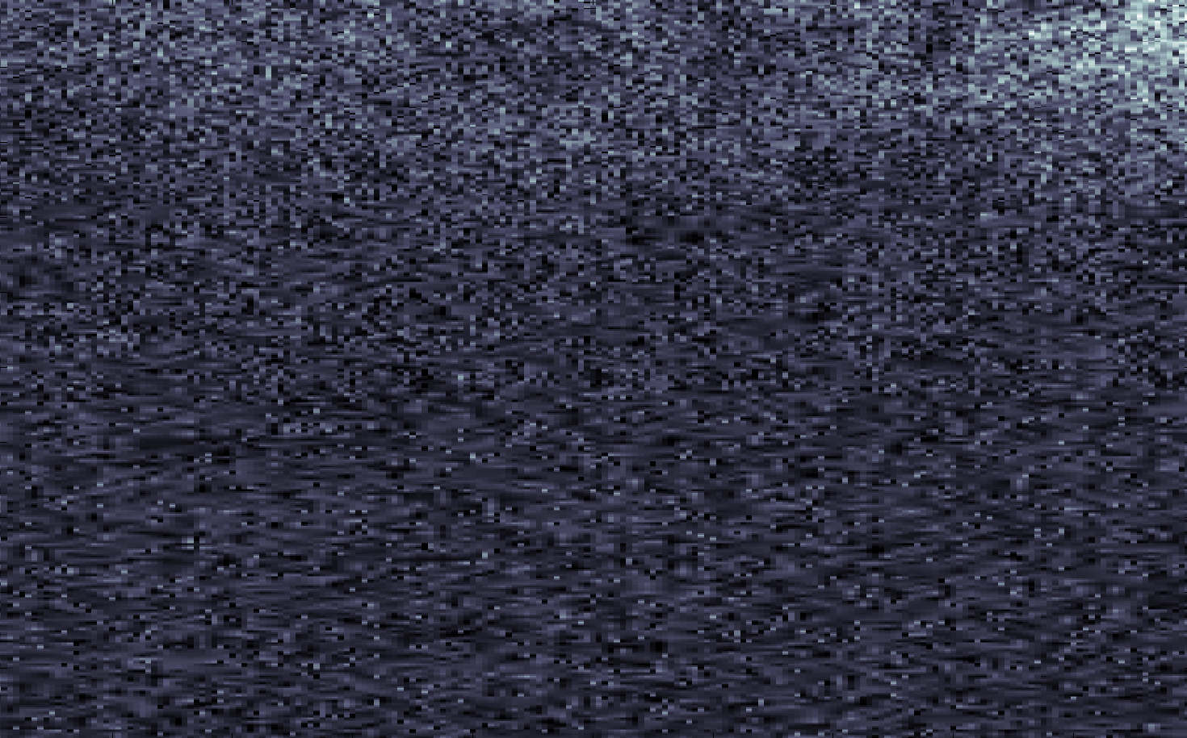
SDd Solvers in Image Denoising?
Optical Coherence Tomography (OCT) scan of retina.
?
Notes:
What if we’re given an actual image?

Slide 16
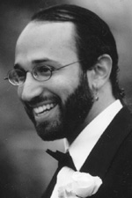
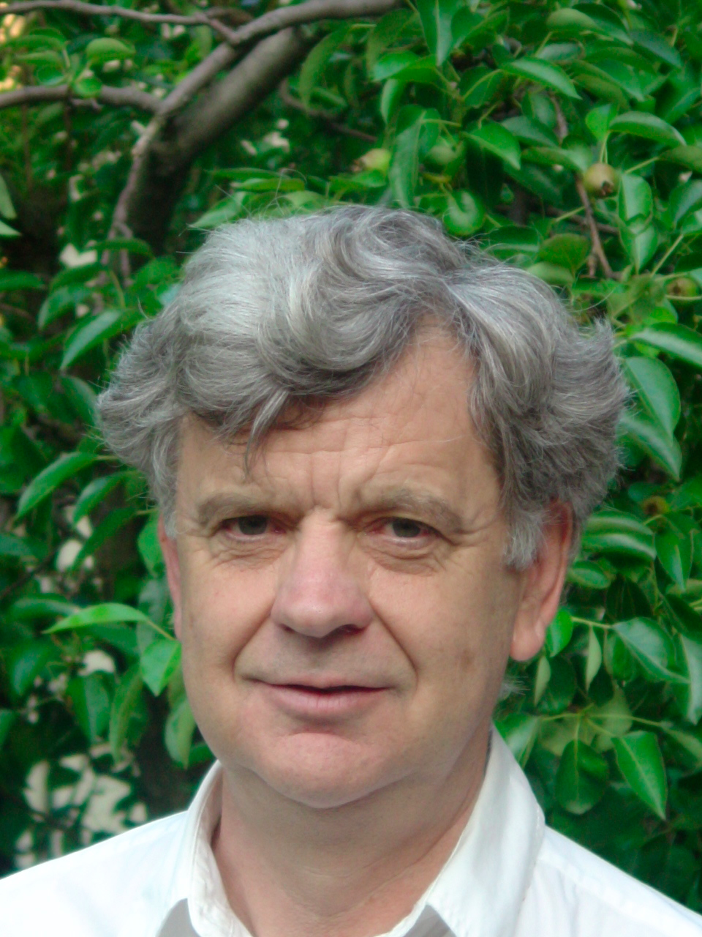
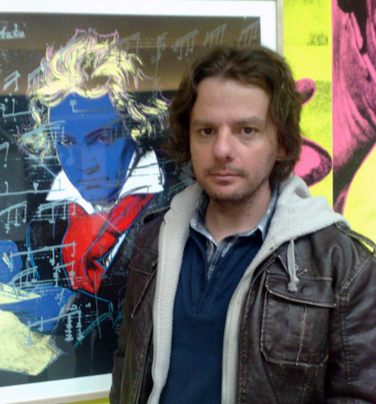
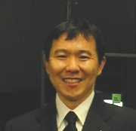
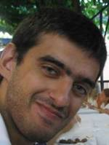
Logs
Runtime: O(mlog^{c}n log(1/ ε))
Estimates on c:
[Spielman]: c≤70
[Miller]: c≤32
[Koutis]: c≤15
[Teng]: c≤12
[Orecchia]: c≤6
When n = 10⁶, log⁶n > 10⁶
Notes:
Key issue: exponent on log
Algorithm isn’t much faster than a O(n²) algorithm on reasonably sized problems

Slide 17
Practical Nearly Linear Time Solvers
[Koutis-Miller-P `10, `11]
Input: n by n SDD matrix A with m non-zeros
vector b
Where: b = Ax for some x
Output: Approximate solution x’ s.t.
|x-x’|_{A}<ε|x|_{A}
Runtime: O(mlogn log(1/ε))
[Blelloch-Gupta-Koutis-Miller-P-Tangwongsan. `11]: Parallel solver, O(m^{1/3}) depth and nearly-linear work
Notes:
Same guarantees, also parallelizable.

Slide 18
Graph Laplacian
A symmetric matrix A is a Graph Laplacian if:
All off-diagonal entries are non-positive.
All rows and columns sum to 0.
`
[Gremban-Miller `96]: solving SDD linear systems reduces to solving graph Laplacians
Notes:
Graph Laplacians are closely related to graphs
Each row/column corresponds to a vertex

Slide 19
High Level Overview
Iterative Methods / Recursive Solver
Spectral Sparsifiers
Low Stretch Spanning Trees

Slide 20
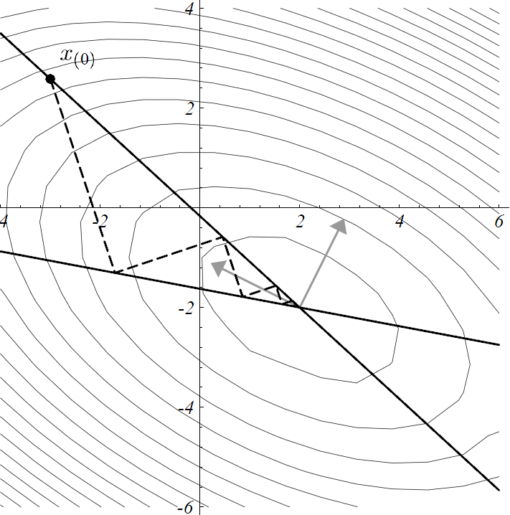
Preconditioning for Linear System Solves
Can solve linear systems A by iterating and solving a ‘similar’ one, B
Needs a way to measure and bound similiarity
[Vaidya `91]: Since A is a graph, B should be as well.
Apply graph theoretic techniques!

Slide 21
Properties B needs
2 ways of easier:
Fewer vertices
Fewer edges
Easier to solve
Similar to A
Can reduce vertex count if edge count is small
Will only focus on reducing edge count while preserving similarity

Slide 22
Graph Sparsifiers
Sparse Equivalents of Dense Graphs
that preserve some property
Spanners: distance, diameter.
[Benczur-Karger ‘96] Cut sparsifier: weight of all cuts.
We need spectral sparsifiers

Slide 23
What we need: ultraSparsifiers
`
`
Given graph G with n vertices, m edges, and parameter k
Return graph H with n vertices, n-1+O(mlog^{p}n/k) edges
Such that G≤H≤kG
Spectral ordering
[Spielman-Teng `04]: ultrasparsifiers with n-1+O(mlog^{p}n/k) edges imply solvers with O(mlog^{p}n) running time.
Notes:
Spectral ordering works almost the same way as scalars

Slide 24
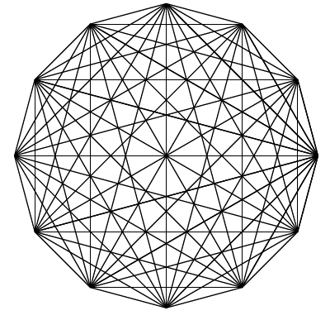
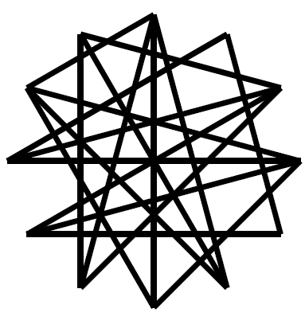
Example: Complete Graph
O(nlogn) random edges (after scaling) suffice!

Slide 25
General Graph Sampling Mechanism
Number of edges kept: ∑_{e} P(e)
For each edge, flip coin with probability of ‘keep’ as P(e).
If coin says ‘keep’, scale it up by 1/P(e).
Expected value of an edge: same
Only need to concentration.
Notes:
Sampling gives the graph in expectation.

Slide 26
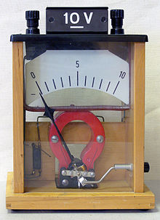
Effective Resistance
`
View the graph as a circuit
Measure effective resistance between uv, R(u,v), by passing 1 unit of current between them
Notes:
Each edge is a resistor with conductance equal to its weight.

Slide 27
Spectral Sparsification by Effective REsistance
[Spielman-Srivastava `08]: Setting P(e) to W(e)R(u,v)O(logn) gives G≤H≤2G
Spectral sparsifier with O(nlogn) edges
Fact: ∑_{e} W(e)R(e) = n-1
*Ignoring probabilistic issues
Ultrasparsifier? Solver???

Slide 28
The Chicken and Egg Problem
How To Calculate Effective Resistance?
[Spielman-Srivastava `08]: Use Solver
[Spielman-Teng `04]: Need Sparsifier
Workaround: upper bound effective resistances

Slide 29
Rayleigh’s Monotonicity Law
`
Rayleigh’s Monotonicity Law:
As we remove edges, the effective resistances between two vertices can only increase.
Calculate effective resistance w.r.t. a spanning tree T
Resistors in series: effective resistance of a path with resistances r₁… r_{k} is ∑_{i} r_{i}

Slide 30
Sampling Probabilities According to Tree
`
Sample Probability: edge weight times effective resistance of tree path
stretch
Number of edges kept: ∑_{e} P(e)
Need to keep total stretch small

Slide 31
Low Stretch Spanning Trees
[Alon-Karp-Peleg-West ‘91]:
A low stretch spanning tree with
Total stretch O(m^{1+ε}) can be found in O(mlog n) time.
[Elkin-Emek-Spielman-Teng ‘05]:
A low stretch spanning tree with
Total stretch O(mlog²n) can be found in O(mlog n + n log² n) time.
[Abraham-Bartal-Neiman ’08, Koutis-Miller-P `11, Abraham-Neiman `12]:
A low stretch spanning tree with
Total stretch O(mlogn) can be found in O(mlog n) time.
Number of edges: O(mlog²n)
Way too big!

Slide 32
What Are We Missing?
What we need:
  H with n-1+O(mlog^{p}n/k) edges
  G≤H≤kG
What we generated:
  H with n-1+O(mlog²n) edges
  G≤H≤2G
Too many edges, but, too good of an approximation
Haven’t used k yet

Slide 33
Work Around
Scale up the tree in G by factor of k, copy over off-tree edges to get graph G’.
G≤G’≤kG
Stretch of Tree edge: 1
Stretch of non-tree edge: reduce by factor of k.
Expected number in H:
Tree edges: n-1
Off tree edges: O(mlog²n/k)
H has n-1+O(mlog²n/k) edges
G’≤H≤2G’
H has n-1+O(mlog²n/k) edges
G≤H≤2kG
O(mlog²n) time solver

Slide 34
solver in Action
Find a good spanning tree
Scale up the tree
Sample off tree edges
`

Slide 35
solver in Action
Eliminate degree 1 or 2 nodes
`

Slide 36
solver in Action
Eliminate degree 1 or 2 nodes
`

Slide 37
solver in Action
Eliminate degree 1 or 2 nodes
`

Slide 38
solver in Action
Eliminate degree 1 or 2 nodes
`

Slide 39
solver in Action
Eliminate degree 1 or 2 nodes
Recurse
Notes:
This gives a O(mlog²n) algorithm

Slide 40
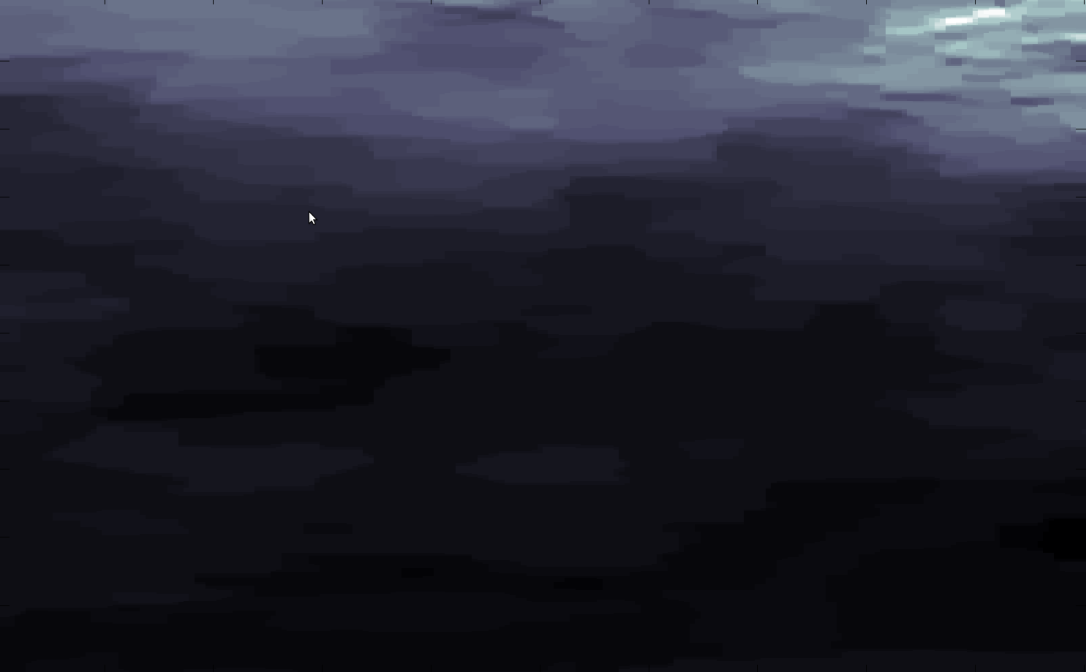
Quadratic minimization in Practice
OCT scan of retina, denoised using the combinatorial multigrid (CMG) solver by Koutis and Miller
Good News: Fast
Bad News: Missing boundaries between layers.
Notes:
Optometrists see that the denoised picture is missing some nerve fiber layers.

Slide 41
Outline
Motivating problem: image denoising
Fast solvers for SDD linear systems
Using solver for L₁ minimization and graph problems.

Slide 42
Total Variation Objective
[Rudin-Osher-Fatemi, 92]
minimizeΣ_{i}(x_{i}-s_{i})² + Σ_{i~j}|x_{i}-x_{j}|
Isotropic variant: partition edges into k groups, take L₂ of each group
Encompasses many graph problems
Notes:
Difference: second term is a sum of absolute values.
Related to LASSO and compressed sensing.

Slide 43
TV using L₂ minimization
[Chin-Mądry-Miller-P `12]: approximate total variation with k groups can be approximated in Õ(mk^{1/3}ε^{-8/3}) time.
Minimize (x_{i}-x_{j})²/w_{ij} instead of |x_{i}-x_{j}|
Equal when |x_{i}-x_{j}|=w_{ij}
Measure difference using the Kullback-Leibler (KL) divergence
Decrease KL-divergence between w_{ij} and differences in the optimum x
Generalization of the approximate maximum flow / minimum cut algorithm from [Christiano-Kelner-Mądry-Spielman-Teng `11].

Slide 44
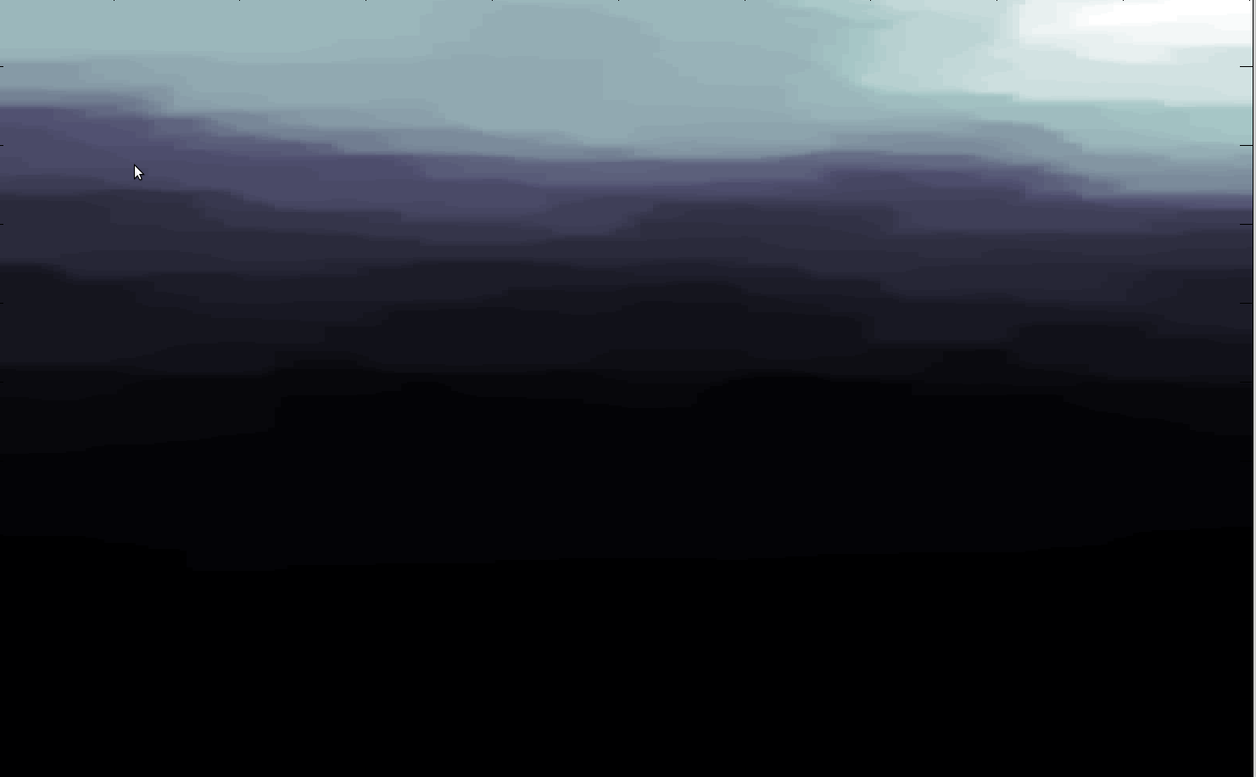
L₂²-L₁ minimization in Practice
L₂²-L₂² minimizer:
Notes:
Sharper image, more clear where boundaries are.
Smaller features disappear

Slide 45
Dual of Isotropic TV: Grouped Flow
Partition edges into k groups.
Given a flow f, energy of a group S equals to √(∑_{eεS} f(e)²)
Minimize the maximum energy over all groups
Running time: Õ(mk^{1/3})
Notes:
K instead of m is crucial, and makes this an interesting subroutine.

Slide 46
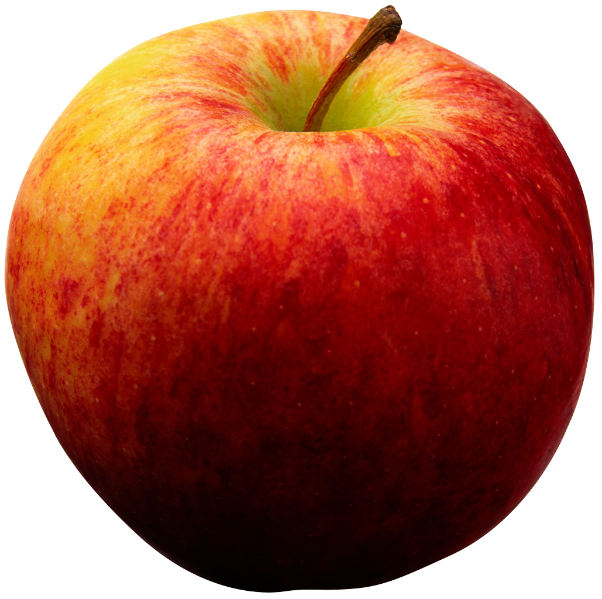
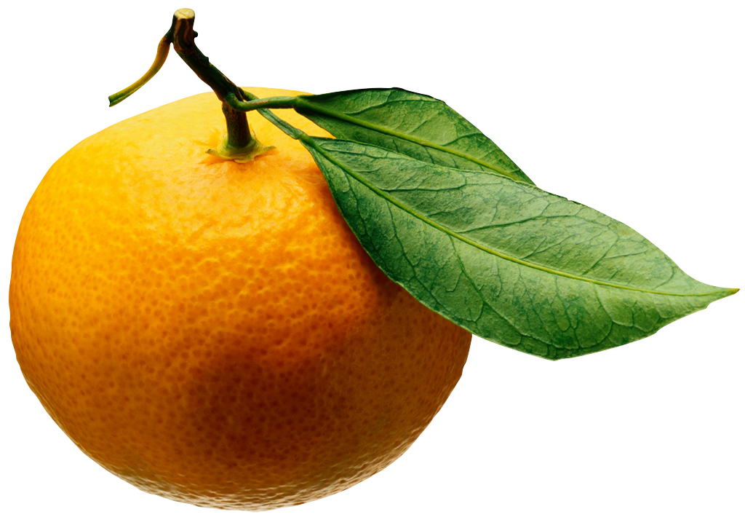
Application of Grouped Flow
Natural intermediate problem.
[Kelner-Miller-P ’12]: k-commodity maximum concurrent flow in time Õ(m^{4/3}poly(k,ε⁻¹))
[Miller-P `12]: approximate maximum flow on graphs with separator structures in Õ(m^{6/5}) time.

Slide 47
Future Work
Faster SDD linear system solver?
Higher accuracy algorithms for L₁ problems using solvers?
Solvers for other classes of linear systems?

Slide 48
Thank You!
Questions?

